Slide 1

Richmond Rising
Collaborative Stakeholder Committee (CSC) Meeting #1
March 6, 2024

Slide 2
Meeting Information
Every first Wednesday of the month.
In-person Attendance: Nevin Community Center, 598 Nevin Ave, Richmond, CA 94801
Virtual Attendance: https://ci-richmond-ca-us.zoom.us/meeting/register/tjwrcu2ortgihtrlu`_bx5erd41g-jfk1epva
Phone Attendance: (669) 900-6833, or (669) 444-9171 Webinar ID: 976 6319 9451

Slide 3
Roll Call
Project lead for City of Richmond
Project lead for Grid
Project lead for Groundworks
Project lead for Rich City Rights
Project lead for Trust for Public Land
Project lead for UC Berkeley
Project lead for Urban Tilth

Slide 4
Land Acknowledgement
While Richmond Rising seeks to strengthen the economy, improve public health and the environment – particularly in the Iron Triangle, Santa Fe and Coronado Neighborhoods, we do so with the awareness that we occupy unceded Huichin and Karkin Ohlone territory.
We acknowledge that land theft of indigenous homelands, and the dismantling of indigenous sovereignty, was done to advance colonization.
We acknowledge that capitalism and white supremacy are branches of colonization that have persisted throughout hundreds of years of oppression, are alive today, and contribute to keeping Black, Indigenous, and all other People of Color from thriving.
We further acknowledge that this country’s political economy and social institutions were built on the forced labor of African people on stolen land through violent, systematic abduction from their homelands and enslavement over hundreds of years.

Slide 5
Land Acknowledgement
We further acknowledge the exploitation of immigrant and refugee communities as modern forms of cheap and disposable labor are regularly carried out on stolen land.
Thus, we acknowledge that we have been impacted and harmed by these histories and experiences imposed on our ancestors and communities. We further uplift the shared struggle among Black, Indigenous, and All People of Color.
We also acknowledge that indigenous people continue to live here, steward the land, and resist settler colonialism.
We conclude that our Land acknowledgement is an active and evolving statement and process. It requires us to recognize historical injustices and invites us in to be active participants in our collective healing.

Slide 6
Richmond Rising
The City of Richmond and 6 local organizations (together known as ‘Richmond Rising’) received $35 million to bring health, economic, and environmental benefits to the
Iron Triangle, Santa Fe, and Coronado neighborhoods.
Richmond Rising is supported by the California Strategic Growth Council’s Transformative Climate Communities Program.

Slide 7
Collaborative Stakeholder Committee
Provides guidance on project implementation and holds us accountable in reaching our goals
Can make recommendations, provide input, and assist Project Leads in implementing project activities
Does not have final decision-making authority
Project Leads must consider recommendations from the Committee and members of the public
Does not have final decision-making authority
All Projects must strongly consider recommendations provided by the Committee and public community

Slide 8
Public Comment –
Items not on the Agenda
This is the space for members of the public to provide public comment on items that are not included in the agenda.

Slide 9
Project Status Reports
Each partner will share up-to-date financials and grant expenditures to date for each project and this will be shared with the Committee and the public.

Slide 10

Insert Grantee
Work completed since last meeting:
  Executed contracts with partners (6/7): Grid Alternatives, Groundworks, Trust for Public Land, Rich City Rides, and Urban Tilth.
  Contracts in process of being executed (1/1): UC Berkeley.
  Agreements in process of City Council Approval (1): Strategic Growth Council Implementation Technical Assistance Grant.
  Hiring of TCC Staff (2/2): Posted, interviewed, hired, and recruited TCC Project Coordinator and TCC Analyst.
  CSC Meeting: Scheduled, coordinated, and currently facilitating CSC meeting #1, including translation, refreshments, and childcare.
  Invoices and Reports: Submitted invoice and progress reports 1, 2, and 3. Invoice 2 has been approved by SGC. Reimbursement check is in process.
Total expenditures reported to date: $62,872.15
Remaining budget: $630,803.51
Planned work in the next ~two weeks:
  CSC Meeting: Circulating meeting summaries.
  Leverage Reports: Coordinate trainings for City Staff and Partners and share forms to report leverage.
  Invoice and Reports: Respond to SGC questions on Invoice 3.
  Payments: Processing and paying invoices from partners.

Slide 11
Insert NCS
Work completed since last meeting:
  Prepared Request for Proposals (RFP).
  Used on-call contract.
  Submitted plans to professional civil design services
  Received proposal to support development of the grant.
Total expenditures reported to date: $ 3,846.71
Remaining budget: $ 5,177,326.43
Planned work in the next ~two weeks:
  Review proposal received.

Slide 12
Insert RWT
Work completed since last meeting:
  Selection of Landscape Architect for the project: PlaceWorks!
Total expenditures reported to date: $ 6,373.36
Remaining budget: $ 4,809,780.24
Planned work in the next ~two weeks:
  Contracting process with Landscape Architect:
    Finalizing scope, budget, and timeline; contract negotiations
  Begin Site Assessment scope by PlaceWorks

Slide 13
Insert Resilient Homes
Work completed since last meeting:
  Grew pipeline of 20 clients
  Conducted canvassing efforts through Iron Triangle and Coronado Neighborhoods
  Provided Solar Assessments for 5 clients
  Provided EE Assessments for 12 clients
Total expenditures reported to date: $ 55,137.76
Remaining budget: $ 6,911,558.15
Planned work in the next ~two weeks:
  Community solar workshop at local businesses

Slide 14
Insert eBLL
Work completed since last meeting:
  Posted, interviewed, hired, eBLL Project Manager.
  Hired Architect to create conceptual designs of eBLL building.
Total expenditures reported to date: $ 0
Remaining budget: $ 2,461,052.00
Planned work in the next ~two weeks:
  Finalize design of eBLL building.
  Develop Design Community Outreach and Engagement Plan for building design.

Slide 15

Project 5: Basins of Relations
Work completed since last meeting:
  Started our new Water Conservation Program, hired Water Conservation Manager.
  Implemented Fall 2023 Basins of Relations Training Program, graduated 8 apprentices from the 15-week intensive training program.
  Hired exceptional program graduates into permanent roles with UT.
  Developed homeowner agreements and outreach plan for upcoming greywater installations.
Total expenditures reported to date: $ 95,687.93
Remaining budget: $ 1,585,015.85
Planned work in the next ~two weeks: Beginning installation of free laundry-to-landscape greywater systems for Iron Triangle Homeowners!

Slide 16

Insert Bosque del Barrio
Work completed since last meeting:
  Drafted Outreach plan, Tree planting plan, and Completed 3 canvassing activities
  Met with City Parks and Recreation department to discuss tree planting opportunities
  Hired key staff for the project –3 hires already
  Cleared and grubbed designated tree planting areas (for match project)
Total expenditures reported to date: $ 40,606.11
Remaining budget: $ 1,047,406.64
Planned work in the next ~two weeks:
Continue canvassing, work with TCC staff to flush out administrative duties, continue working on match project.

Slide 17
Project 7: ADA Garden
Work completed since last meeting:
  Final design feedback session with target demographic to adjust ADA Garden Design
  Pre-Application meeting with the City of Richmond
  Walk through of the proposed garden site with project coordinator, design architect team, City of Richmond, and electrical engineers
Total expenditures reported to date: $ 22,473.98
Remaining budget: $ 932,570.02
Planned work in the next ~two weeks:
  Begin drafting construction documents
  Prepare submittal for Design Review Board

Slide 18
Project 8: Orchard for ALL!
Work completed since last meeting:
  Conducted interviews to hire a Gleaners coordinator to expand the OFA! Team
  Sourced 400 trees for our annual Fruit Tree Giveaway from Planting Justice
  Sent out postcard mailers to the project area to inform them about the Annual Fruit Tree Giveaway
  Created Gleaners Program Outreach Plan
Total expenditures reported to date: $ 30,969.81
Remaining budget: $ 1,137,243.82
Planned work in the next ~two weeks:
  Host 6th Annual Fruit Tree Giveaway at Unity Park Plaza
  Hire Gleaners Coordinator
  Begin to follow up with Fruit Tree Giveaway Recipients -#

Slide 19
Project 9: Veggie Rx
Work completed since last meeting:
  Began interview process for new Veggie Rx Project Manager
  Refined MOU with Lifelong
  Set reoccurring meeting with project team to build a clear pathway towards expansion to goal of 200 bag recipients
Total expenditures reported to date: $ 18,007.88
Remaining budget: $ 3,238,872.00
Planned work in the next ~two weeks:
  Hire and begin onboarding and training new Veggie Rx Project Manager
  Finalize invoice 1 & 2 backbilling
  Finalize all tracking and process documents for billing and patient referral management
  Design templates for annual distribution log and procurement reports

Slide 20
Insert e-Bike Share
Work completed since last meeting:
  Continued work with community-based organizations
  Launched the eBike system / Ribbon cutting ceremony
  Trained hired staff
  In the process of hiring a Community Manager to work with stakeholders and the community
  Completed a Community Outreach and Engagement Plan for implementation
Total expenditures reported to date: $1,094,375
Remaining budget: $3 million
Planned work in the next ~two weeks: place additional bikes throughout the City at identified locations.

Slide 21
Insert CEP
Work completed since last meeting:
  Begin drafting Richmond Rising website
  Begin drafting Engagement Plan
  Draft Youth Fellow Manager job description
  Draft Annual Youth Fellows reporting documents
    Youth Fellows Community Engagement Log
  Youth Fellows Community Engagement Summary
Total expenditures reported to date: $ 2,383.55
Remaining budget: $ 2,563,649.18
Planned work in the next ~two weeks:
  Finish Community Engagement Plan

Slide 22
Insert DAP
Work completed since last meeting:
  Draft ADU Guidebook completed; presented at ADU workshop February 28, 2024
  Public Land Policy Framework completed; presented to City Council March 5, 2024
  Secured ARPA funding for Buy Local campaign and Façade Improvement Pilot Program
  ADU Workshop held on February 28th.
Total expenditures reported to date: $44,160.54
Remaining budget: $ 637,475.08
Planned work in the next ~two weeks:
  Refine ADU Guidebook and incorporate ADU Workshop feedback.
Notes:
Public land policy framework proposes facilitating the development of permanently affordable housing with a preference for CLT development on vacant city owned land.

Slide 23
WDEOP
Work completed since last meeting: N/A
Total expenditures reported to date: $ 4,430.20
Remaining budget: $ 1,429,377.54
Planned work in the next ~two weeks:
  Review job applications to hire a new staff member.
  Identify another location in the TCC area to implement the training program.

Slide 24
Insert ITP
Work completed since last meeting:
  Continued drafting evaluation & indicator tracking plan
  Developed reporting tools for data collection
  Collected Richmond-based baseline data
Total expenditures reported to date: $ 90,000
Remaining budget: $ 980,000.00
Planned work in the next ~two weeks:
  Share draft evaluation & indicator tracking plan for feedback
  Schedule meetings with project partners to discuss data collection process

Slide 25

Insert ITP
Work completed since last meeting:
  Continued drafting evaluation & indicator tracking plan
  Developed reporting tools for data collection – google sheet for events, community engagement, etc.
  Also inputs for CARB - (water savings, energy, tree canopy, ridership on e-bikes, etc)
  Collected Richmond-based baseline data
Total expenditures reported to date: $ 90,000
Remaining budget: $ 980,000.00
Planned work in the next ~two weeks:
  Share draft evaluation & indicator tracking plan for feedback
  Schedule meetings with project partners to discuss data collection process

Slide 26
Report on Community Questions and Comments Received
Report out on any community questions or comments received, including responses

Slide 27
Committee Business Items for Discussion
Governance procedures
Committee member roles and responsibilities
Key Committee priorities
Nomination process for community seats
Public Kickoff Planning (Earth Day event: April 20th, 2024)

Slide 28
Governance Procedures: Rosenberg's Rules of Order
Quorum requirements. Majority of the committee: 4/7
Each discussion item requires the following format:
  Report including recommendations
  Technical clarifications
  Opportunity for public comment
  If a decision is to be made:
    Motion
    Second
    Repeat the motion
    Committee discussion
    Vote
    Announce result of vote (name who voted in the minority) and what action (if any) the committee will take

Slide 29
Roles and Responsibilities
Committee shall have at least 14 members
  One Project Lead for each of the six partner organizations
  Two youth aged 16-24 from Youth Fellow Cohort
  Three to six seats shall be ‘community seats’
    Must be residents, or individuals that operate a business or organization
    in the project area
    Should also reflect each of the neighborhoods of the project area
No more than three unexcused absences
Community Agreements

Slide 30
Community Agreements
We take care of ourselves - stretch, eat, drink, use the restroom, rest, etc.
We are curious, open, and respectful of the opinions and perspectives of others
We come with an open mind and avoid judging other people
We give the benefit of the doubt and ask questions
We don't speak for others without explicit permission, and don't share something communicated to us in a private or safe space.
We use one mic - one voice at a time.
Take Space/Make Space - if we are usually quiet, we challenge ourselves to take more space, and if we usually talk a lot, we are mindful to leave room for quieter voices
We avoid jargon, acronyms, and industry language - use inclusive language that is accessible for people with varying inside knowledge.
We speak from our own experience - Use “I” statements, rather than generalizations.
We challenge assumptions.
We are conscious of intent vs. impact – no matter our intention, we're responsible for our impact
Together we know a lot, no one knows everything

Slide 31
Officer Appointments
A two-thirds vote is required to appoint the following Officer positions (two-year term):
  Chair
  Co-Chair
  Secretary
Responsibilities: convening and presiding over meetings, distributing meeting minutes
Additional responsibilities to be discussed as part of development and adoption of CSC bylaws

Slide 32
Appoint special committee to draft CSC procedures, goal, and vision
Appoint at least five members to review and make recommendation for CSC adoption:
  Bylaws (draft circulated)
  Key priorities
  Goal and vision statement
To be finalized by third CSC meeting

Slide 33
Nominating Community Seats
Draft nomination form circulated
Nomination process will be open to all members of the public who live in or represent an organization located within the Project Area
Community members may be self-nominated or nominated by someone else
CSC to appoint community seats by a two-thirds vote

Slide 34
Public Kickoff Planning
Public kickoff event planned for Earth Day (April 20th)
Present final Richmond Rising Logo
Review draft event mailer

Slide 35


Slide 36


Slide 37


Slide 38


Slide 39
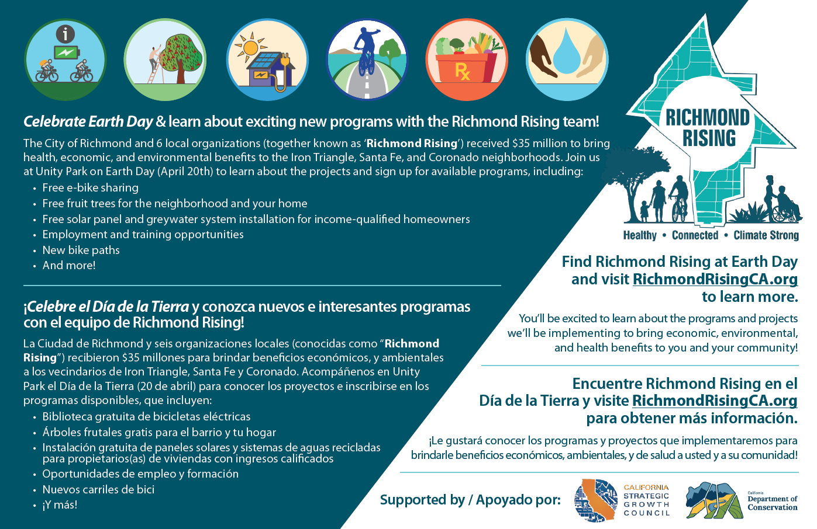

Event Mailer

Slide 40
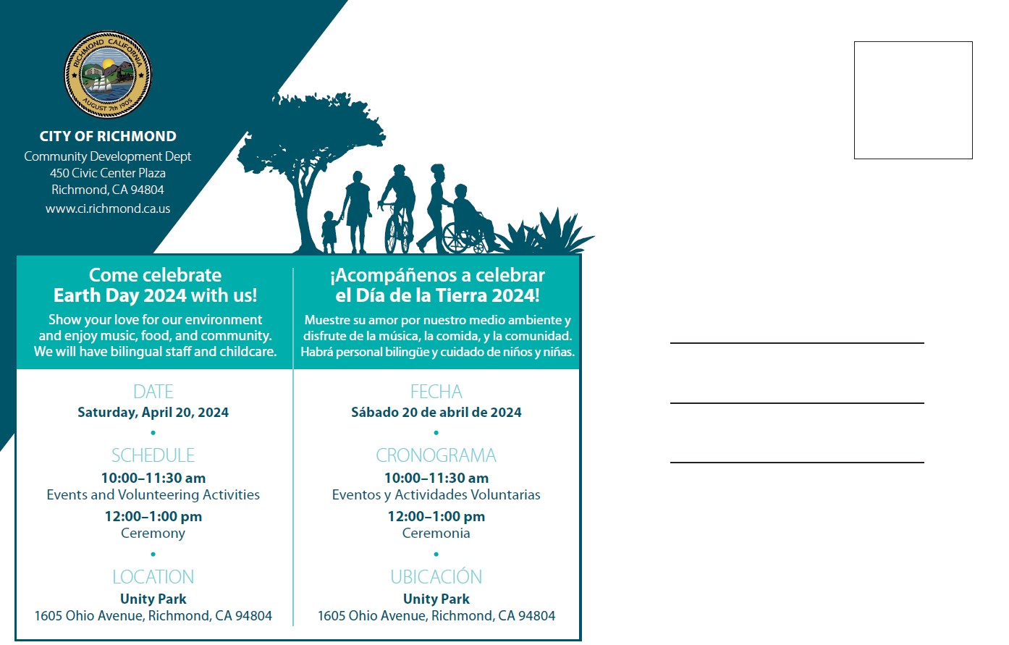
Event Mailer

Slide 41
Agenda Requests for Next Meeting
Discussion of items to be covered in next CSC meeting

Slide 42
General Announcements
CSC Members, members of the public, and other partners or organizations are encouraged to share information or announcements related to upcoming events, projects, or programs in the Project Area

Slide 43
Meeting adjourned.
Thank you!

Slide 44
Richmond Rising Collaborative Stakeholder Committee (CSC) Meeting
March 6, 2024

