Slide 1

Richmond Rising
Collaborative Stakeholder Committee (CSC)
October 2, 2024

Slide 2
Roll Call
Project lead for City of Richmond
Project lead for GRID Alternatives
Project lead for Groundwork Richmond
Project lead for Rich City Rides
Project lead for Trust for Public Land
Project lead for UC Berkeley
Project lead for Urban Tilth
Community member: Tomasa Espinoza
Community member: Juana Hernandez
Community member: Montserrat Gonzalez
Community member: Judith Rocha

Slide 3
Meeting Information
Every first Wednesday of the month 6:00 – 8:00 pm.
In-person Attendance: Nevin Community Center
598 Nevin Ave, Richmond, CA 94801
Virtual Attendance: https://ci-richmond-ca-us.zoom.us/webinar/register/wn_gx8xwknptcutbnefzdbv1w
Phone Attendance: (669) 900-6833, or (669) 444-9171
Webinar ID: 976 6319 9451
All Committee members and members of the public must abide by the Community Agreements

Slide 4
Land Acknowledgement
While Richmond Rising seeks to strengthen the economy, improve public health and the environment – particularly in the Iron Triangle, Santa Fe and Coronado Neighborhoods, we do so with the awareness that we occupy unceded Huichin and Karkin Ohlone territory.
We acknowledge that land theft of indigenous homelands, and the dismantling of indigenous sovereignty, was done to advance colonization.
We acknowledge that capitalism and white supremacy are branches of colonization that have persisted throughout hundreds of years of oppression, are alive today, and contribute to keeping Black, Indigenous, and all other People of Color from thriving.
We further acknowledge that this country’s political economy and social institutions were built on the forced labor of African people on stolen land through violent, systematic abduction from their homelands and enslavement over hundreds of years.

Slide 5
Land Acknowledgement
We further acknowledge the exploitation of immigrant and refugee communities as modern forms of cheap and disposable labor are regularly carried out on stolen land.
Thus, we acknowledge that we have been impacted and harmed by these histories and experiences imposed on our ancestors and communities. We further uplift the shared struggle among Black, Indigenous, and All People of Color.
We also acknowledge that indigenous people continue to live here, steward the land, and resist settler colonialism.
We conclude that our Land acknowledgement is an active and evolving statement and process. It requires us to recognize historical injustices and invites us in to be active participants in our collective healing.

Slide 6
Richmond Rising
The City of Richmond and 6 local organizations (together known as ‘Richmond Rising’) received $35 million to bring health, economic, and environmental benefits to the Iron Triangle, Santa Fe, and Coronado neighborhoods.
Richmond Rising is supported by the California Strategic Growth Council’s Transformative Climate Communities Program.

Slide 7
Collaborative Stakeholder Committee
Provides guidance on project implementation and holds us accountable in reaching our goals
Can make recommendations, provide input, and assist Project Leads in implementing project activities
Does not have final decision-making authority
Project Leads must consider recommendations from the Committee and members of the public

Slide 8
Public Comment Not on the Agenda
This is the space for members of the public to provide public comment on items that are not included in the agenda.

Slide 9
Review and Approve Previous Meeting Minutes
Members to review and approve previous meeting minutes

Slide 10
Project Status Reports
Each partner will share up-to-date financials and grant expenditures to date for each project and this will be shared with the Committee and the public.

Slide 11

Grantee
Work completed since last meeting:
  CSC Meeting: Scheduled, coordinated, and currently facilitating CSC meeting #9, including translation, refreshments, and childcare.
  Invoices and Reports:
      Received reimbursement check for Invoice #5. Made edits on Invoice and Progress Report#6, for months of June and July, after reviews were provided. Invoice #6 got approved by Department of Conservation and we're waiting for final SGC approval and check reimbursement.
      Calendar for Invoice #7 has been sent, and office hours have been sent to partners.
Total expenditures reported to date: $ 191,643.09
Remaining budget: $ 502,032.57
Planned work in the next ~two weeks:
  Host invoice #7 office hours.
  Get approval from SGC for Progress Report and Invoice #6

Slide 12
Neighborhood Complete Streets
Work completed since last meeting:
  Held biweekly coordination meetings between consultant team (CSW) and city staff.
  Continued weekly coordination with Trust for Public Land for application for US Department of Transportation Reconnecting Communities Pilot Program (RCP) and submitted the application on 09/01/2024.
Total expenditures reported to date: $ 8,121.28
Remaining budget: $ 5,173,051.87
Planned work in the next ~two weeks:
  Coordinate Neighborhood Complete Streets town hall at Nevin Community
  Center on November 16th, from 12:00 to 2:00pm.
  Continue working on project design.

Slide 13

Richmond Wellness Trail
Work completed since last meeting:
  Researching additional funding sources in partnership with COR/Neighborhood Complete Streets
  Analysis of base maps, design analysis of site (opportunities, constraints, etc.)
  Held coordination meetings between consultant team (PlaceWorks + subconsultants), project management team (Trust for Public Land), City staff, and project stakeholders
  Organized a Project Site Walk to discuss collaborative relationships, order of operations, project design opportunities & constraints, etc.
  Planning and coordination of project.
  Planning and coordination of community engagement.
  30% drawings completed by PlaceWorks submitted to TPL and COR.
Total expenditures reported to date: $ 31,127.12
Remaining budget: $ 4,785,026.48
Planned work in the next ~two weeks:
  Continued Design Work and Community Engagement Planning.

Slide 14

e-Bike Lending Library
Work completed since last meeting:
  Hired Outreach program manager.
  Outreach: Partnered with Urban Tilth, Richmond Fire Department and RICH CITY Rollers and hosted our annual Roller Disco Party.
  Outreach: Hosted our Annual Clean Air Drive.
Total expenditures reported to date: $ 99,128.48
Remaining budget: $ 2,361,923.51
Planned work in the next ~two weeks:
  Submitting plans for building approval.

Slide 15

Resilient Homes
Work completed since last meeting:
  Solar workshop at Atchinson Village on Sept 28th
  A/V GRID Solar Workshop October 2nd
  Completed Internal Resilient Homes Team TCC Year End Review
  Installed Solar Battery Storage for 3 TCC Clients
Total expenditures reported to date: $ 356, 816.91
Remaining budget: $ 6,609, 879.00
Planned work in the next ~two weeks:
Bi-Monthly TCC Reporting

Slide 16

Basins of Relations
Work completed since last meeting:
  Hired additional Water Conservation apprentice to support with Water Conservation installations.
  Installed 1 new laundry-to-landscape greywater recycling system, and 4 drip irrigation systems for Iron Triangle homeowners.
  Professional development to improve our team's skills in Water Catchment system installation.
Total expenditures reported to date: $ 146,325.22
Remaining budget: $ 1,534,378.56
Planned work in the next ~two weeks:
  Ongoing outreach and installation of Water Conservation technologies for Iron Triangle homeowners.

Slide 17

Bosque del Barrio
Work completed since last meeting:
  Continued to canvass in the Iron Triangle, Coronado, and Santa Fe neighborhoods for Tree-Adoptees
  78 total trees planted to date
Total expenditures reported to date: $ 80,072.72
Remaining budget: $ 1,007,940
Planned work in the next ~two weeks:
  Arbor Day event on Oct. 19th at South Side Park
  Hiring Admin Assistant

Slide 18
ADA Accessible Garden
Work completed since last meeting:
  Submitted 95% plans for construction cost estimates.
  Drafted Ambassador Agreement and Muralist Agreement.
Total expenditures reported to date: $ 38,072.75
Remaining budget: $ 916,246.00
Planned work in the next ~two weeks:
  Submit plans for City review and permitting.
  Coordinate schedule with the County for CDBG.

Slide 19
Orchard for ALL!
Work completed since last meeting:
  Created a Curriculum and planning out winter apprenticeship
  Created and separated forms of gleaning and tree care( make new flyers and
  Canvased in project area with direct sign up for both tree care and gleaning.
  Participated in different community events to sign more people up for our free services.
Total expenditures reported to date: $ 67,051.87
Remaining budget: $ 1,101,161.76
Planned work in the next ~two weeks:
  Prepare all lessons and documents for winter apprenticeship.
  Canvassing area of Santa Fe.
  Purchased and prepared necessary tools for winter tree care.

Slide 20
Veggie Rx
Work completed since last meeting:
  Increased CalAim VeggieRx enrollment by 5 patients.
  Launched Phase I of the VeggieRx website: www.urbantilthveggierx.org
  Planned next 3 Climate Friendly Diet (CFD) events:
    Sip Smart (a collaboration with Urban Tilth's Free Farm Stands): 9/30 @ 3:00pm, Unity Park
    Atchison Village Community Day: 9/29 @ 11:00am, 270 Curry Street
    CFD workshop: 10/23 @ 12:00pm, Shields Richmond Nursing Center
Total expenditures reported to date: $ 259,588.96
Remaining budget: $ 2,979,283.04
Planned work in the next ~two weeks:
  Write letters, emails, and gather patient testimonials in opposition to newly
  proposed benefit restrictions for CalAIM Medically Tailored Meals Community
  Supports Program, since the changes would drastically limit who is eligible.

Slide 21
E-Bike Share
Work completed since last meeting:
  Installation of 3 bike hubs in the Project Area.
  Distribution of ride vouchers to increase community awareness and knowledge.
Total expenditures reported to date: $ 361,544.30
Remaining budget: $ 637,434.91
Planned work in the next ~two weeks:
  Continue outreach and distribution of ride vouchers.

Slide 22
Community Engagement Plan
Work completed since last meeting:
  Tabled at the Roller Disco Party at Unity Park on Saturday September 29th to share information about TCC Projects and Youth Fellow Program.
  Finished drafting onboarding documents for Youth Fellow Program.
    Waiting for Feedback Review from TCC Coordinators and legal team.
Total expenditures reported to date: $ 92,735.62
Remaining budget: $ 2,473,297.11
Planned work in the next ~two weeks:
Complete draft of modules and training materials for Youth Fellow Program by mid-October.
Provide feedback to onboarding documents for Youth Fellow Program.

Slide 23
Displacement Avoidance Plan
Work completed since last meeting:
ADU tool kit:
  Presented revised architectural drawings to Design Review Board (DRB) for feedback.
  City submitted and reviewed the 50% permit set for City review .
Buy Local Campaign:
  Finalized RFP/Q for the Buy Local Campaign Marketing and Event Consultant and received 5 proposals
  Proposals were reviewed by a panel.
  RFQ for Buy Local platform was posted on PlanetBids235
Total expenditures reported to date: $ 104,562.44
Remaining budget: $ 577,073.18
Planned work in the next ~two weeks:
Interviews to be completed for Events and Marketing RFQ by the end of the week.
  Selection of the Buy Local Campaign Marketing and Event Consultant.
  Taste of Richmond Restaurant Week on October 7-13th. https://www.tasteofrichmondca.com/
  Consultant team working on ADU toolkit will submit !00% design set to the City.
Notes:
The levying of taxes for DRPBID is applicable to many parcels in the downtown area. The money goes to improving the Downtown area and is also the budget for Richmond Main Street Initiative.

Slide 24
Workforce Development and Economic Opportunity Plan (WDEOP)
Work completed since last meeting:
  Biweekly meetings between Glen Price Group team and grantee.
  Received first draft of Place-Based Workforce Development Strategy for City's review.
  Continued recruitment for YouthBUILD for residents of the Project Area.
Total expenditures reported to date: $ 11,370.21
Remaining budget: $ 1,422,437.53
Planned work in the next ~two weeks:
  GRID Alternatives finish building out the labs for solar training.
  Finish review of Place-Based Workforce Development Strategy.
  Finish Workforce Development Strategy Planning Session.

Slide 25

Indicator Tracking Plan
Work completed since last meeting:
  Finalized new data tracking tool for all partners and submitted to the City for review.
  Received baseline data for CARB tools from SGC.
Total expenditures reported to date: $ 0
Remaining budget: $ 1,070,000
Planned work in the next ~two weeks:
  Receive comments from City staff about data collection tool and send it to partners.

Slide 26
Report on Public Comments & Questions
Report out on any community questions or comments received, including responses

Slide 27
Committee Items for Discussion
Neighborhood Complete Streets Presentation
CSC Community Member Nominations
Annual Report to Richmond City Council
Reconnecting Communities Pilot Grant

Slide 28
Neighborhood Complete Streets Presentation
Public comment
Committee discussion
Decision or recommendation

Slide 29
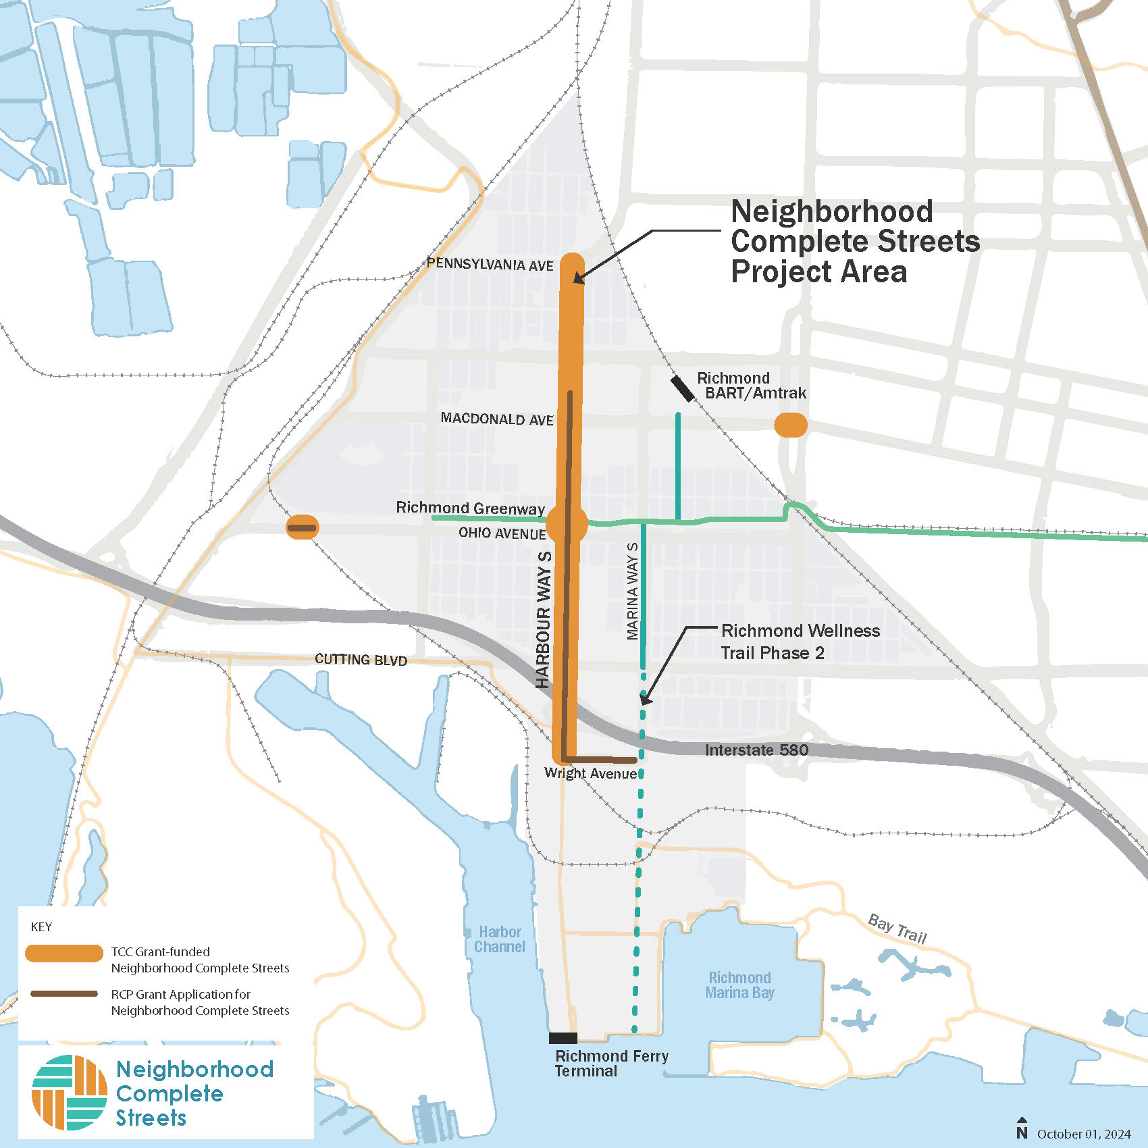
Neighborhood Complete Streets
  The Neighborhood Complete Streets project focuses on improving walking and biking access for residents of the Iron Triangle, Santa Fe, and Coronado neighborhoods.
  The project will support connections between neighborhoods, downtown Richmond, the Richmond Greenway, and the Richmond Ferry terminal.

Slide 30
Neighborhood Complete Streets
  This project will improve conditions for walking, biking, and taking the bus on:
  Harbour Way South
  Ohio Avenue
  Macdonald Avenue
  Additional grant funding may become available for street lighting and signal improvements, as well as continuous sidewalks on Wright Avenue.

Slide 31
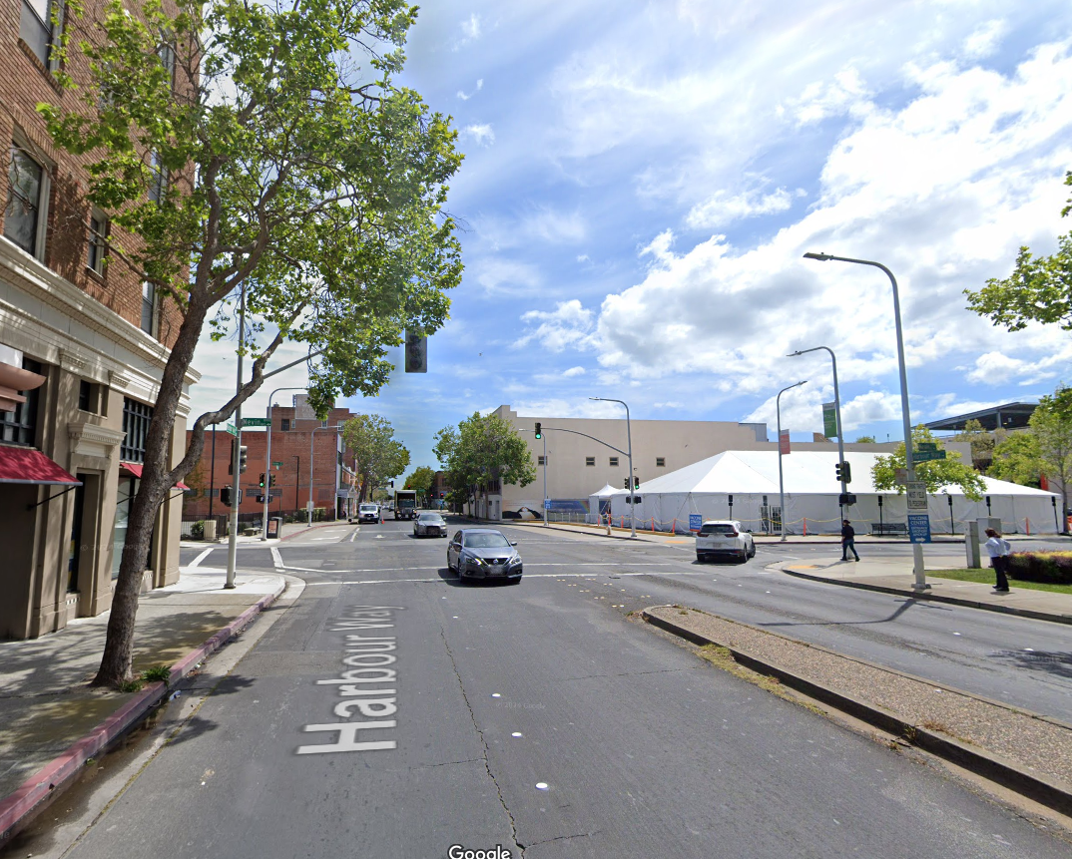
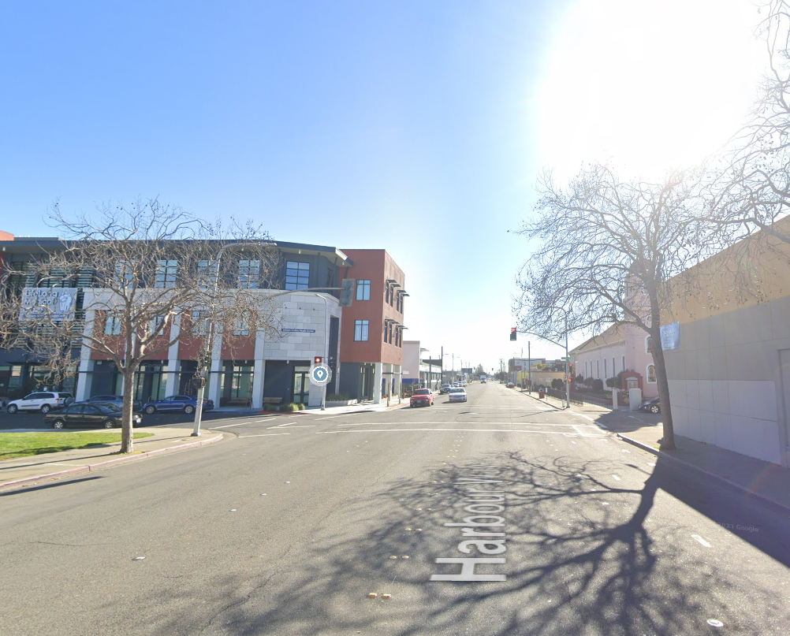
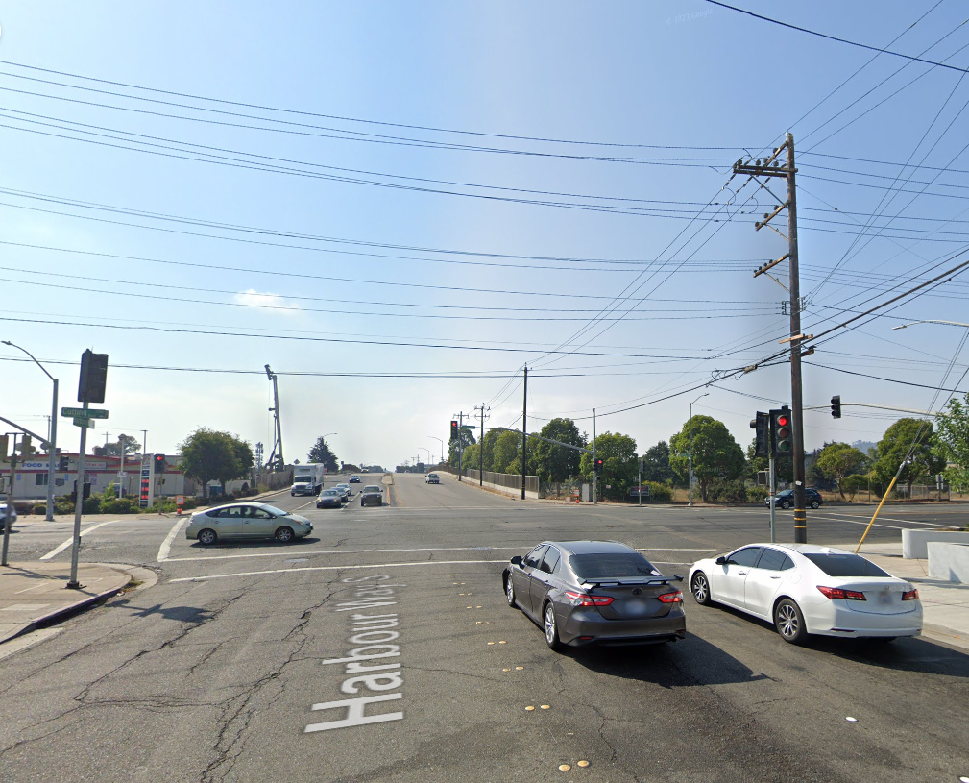
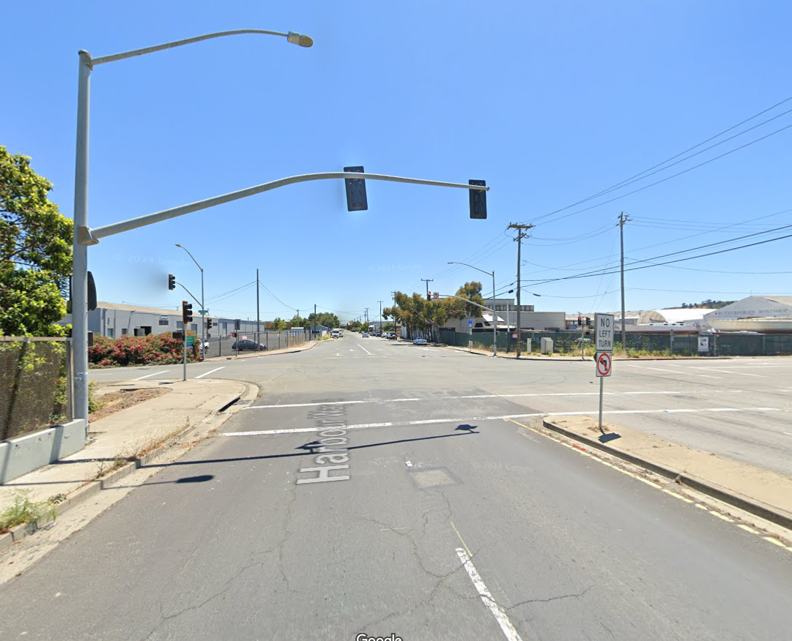
Neighborhood Complete Streets
  Harbour Way South
  Harbour Way S is a primary north/south connection between the Richmond Ferry, the Richmond Greenway and downtown.
  North of Interstate 580, the project will provide new bicycle lanes, update pedestrian curb ramps, and modernize traffic signals to improve safety and accessibility.
  The project will improve the Interstate 580 crossing and address gaps and out-of-date infrastructure south of the freeway.

Slide 32
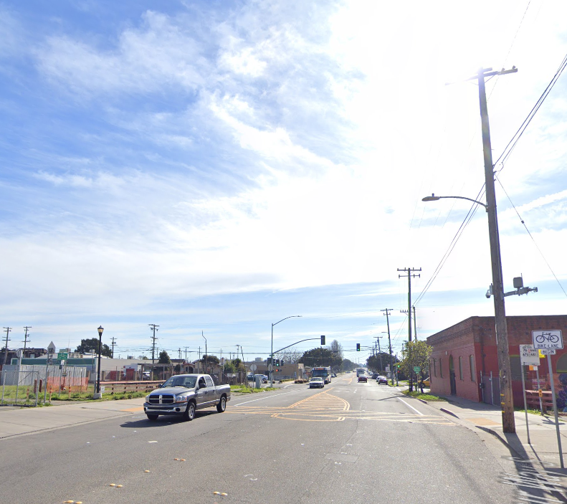
Neighborhood Complete Streets
  Harbour Way South & The Richmond Greenway.
  The Richmond Greenway is a key east/west link to destinations across the City.
  The project will consider a range of improvements for people walking, biking and taking the bus at the intersection of the Richmond Greenway with Harbour Way S.
RICHMOND GREENWAY
OHIO AVE

Slide 33
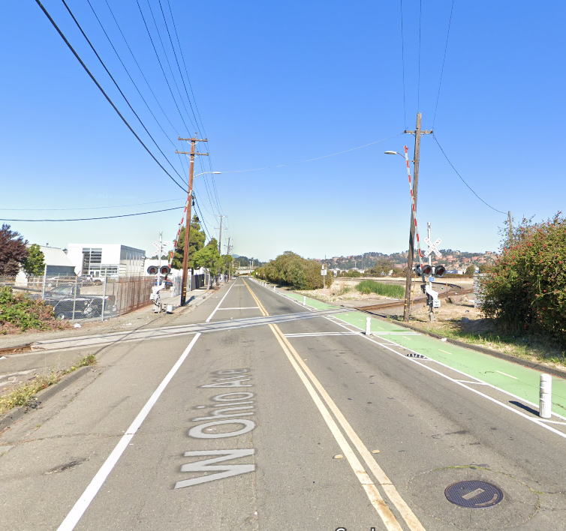
Neighborhood Complete Streets
  Ohio Avenue
  Ohio Avenue serves as a crucial east-west connector, linking the Richmond Greenway at Second Street to destinations in Point Richmond.
  The project will complete the crossing of the BNSF tracks along Ohio Avenue’s two-way Class IV cycle track.

Slide 34
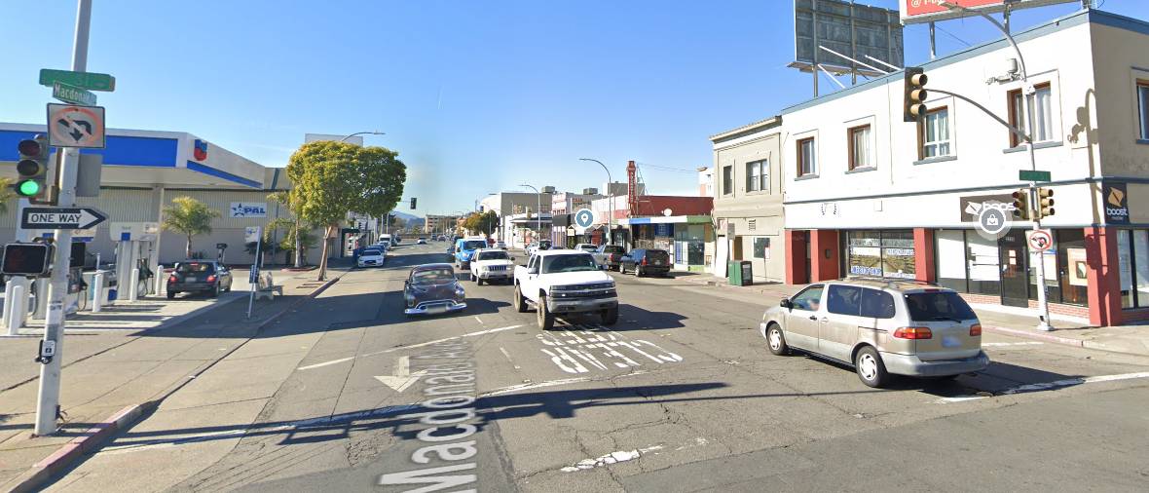
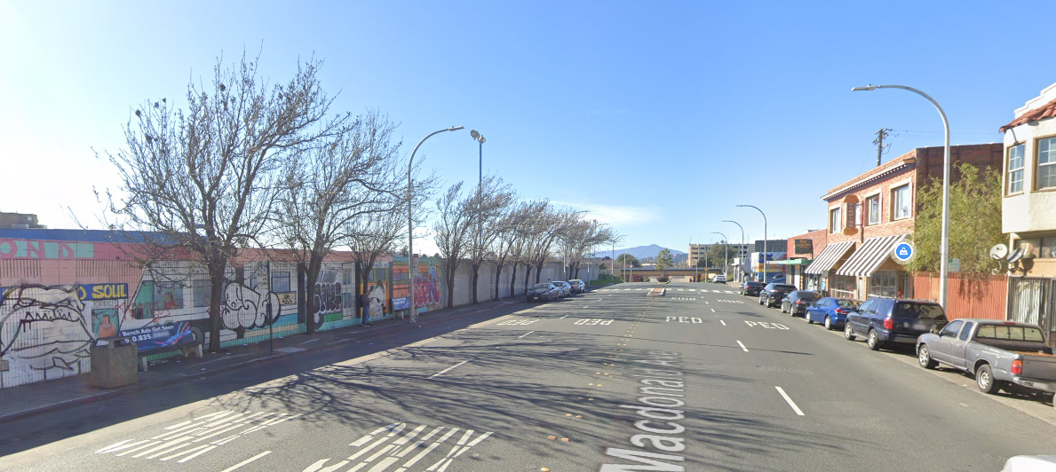
Neighborhood Complete Streets
  Macdonald Avenue Bus Stops
  The project will enhance the existing AC Transit bus stops on Macdonald Avenue between 21st and 23rd streets.
  Potential enhancements include shelters, lighting, and accessibility improvements.

Slide 35
Neighborhood Complete Streets
We are here
Nosotros estamos aqui
Project Kick off
Inicio del proyecto
Permitting and Construction
Permisos y Construcción
Preliminary Design
Diseño Preliminar
50% Design
Diseño básico
Final Design
Diseño Final
#1
#2
#3
#4
Town Halls
Los Talleres

Slide 36
Neighborhood Complete Streets
You are invited
Nosotros estamos aqui
Project Kick off
Inicio del proyecto
Permitting and Construction
Permisos y Construcción
Preliminary Design
Diseño Preliminar
50% Design
Diseño básico
Final Design
Diseño Final
#1
#2
#3
#4
November 16, 2024
12pm – 2pm
Nevin Community Center
598 Nevin Ave, Richmond
16 de noviembre de 2024
12:00 – 14:00 horas
Centro Comunitario Nevin
598 Nevin Ave, Richmond

Slide 37
Neighborhood Complete Streets
  What do you want the team to know?
  bit.ly/NeighborhoodCompleteStreets

Slide 38
CSC Community Member Nominations​
Review and make recommendations on nomination forms received by the Committee. Review to occur bimonthly.

Slide 39
Annual Report to Richmond City Council
Public comment
Committee discussion
Decision or recommendation

Slide 40
Reconnecting Communities Pilot Grant
Public comment
Committee discussion
Decision or recommendation

Slide 41
Upcoming SGC Site Visit on Nov. 14th
Times?
Sites?
Events?
Other considerations?

Slide 42
Agenda Requests for Next Meeting

Slide 43
General Announcements
CSC Members, members of the public, and other partners or organizations are encouraged to share information or announcements related to upcoming events, projects, or programs in the Project Area

Slide 44
Meeting Adjourned
Thank You!
Questions? Comments?
Please reach out at
tcc@ci.richmond.ca.us

