Slide 1

Richmond Rising
Collaborative Stakeholder Committee (CSC)
January 8, 2025

Slide 2
Roll Call
Project lead for City of Richmond
Project lead for GRID Alternatives
Project lead for Groundwork Richmond
Project lead for Rich City Rides
Project lead for Trust for Public Land
Project lead for UC Berkeley
Project lead for Urban Tilth
CSC Community Member: Tomasa Espinoza
CSC Community Member: Juana Hernandez
CSC Community Member: Montserrat Gonzalez
CSC Community Member: Judith Rocha
CSC Community Member: Curtis Rice
CSC Community Member: Jim Becker

Slide 3
Meeting Information
Every first Wednesday of the month 6:00 – 8:00 pm.
In-person Attendance: Nevin Community Center 598 Nevin Ave, Richmond, CA 94801
Virtual Attendance: https://ci-richmond-ca-us.zoom.us/webinar/register/wn_gx8xwknptcutbnefzdbv1w
Phone Attendance: (669) 900-6833, or (669) 444-9171 Webinar ID: 976 6319 9451
All Committee members and members of the public must abide by the Community Agreements

Slide 4
Land Acknowledgement
While Richmond Rising seeks to strengthen the economy, improve public health and the environment – particularly in the Iron Triangle, Santa Fe and Coronado Neighborhoods, we do so with the awareness that we occupy unceded Huichin and Karkin Ohlone territory.
We acknowledge that land theft of indigenous homelands, and the dismantling of indigenous sovereignty, was done to advance colonization.
We acknowledge that capitalism and white supremacy are branches of colonization that have persisted throughout hundreds of years of oppression, are alive today, and contribute to keeping Black, Indigenous, and all other People of Color from thriving.
We further acknowledge that this country’s political economy and social institutions were built on the forced labor of African people on stolen land through violent, systematic abduction from their homelands and enslavement over hundreds of years.

Slide 5
Land Acknowledgement
We further acknowledge the exploitation of immigrant and refugee communities as modern forms of cheap and disposable labor are regularly carried out on stolen land.
Thus, we acknowledge that we have been impacted and harmed by these histories and experiences imposed on our ancestors and communities. We further uplift the shared struggle among Black, Indigenous, and All People of Color.
We also acknowledge that indigenous people continue to live here, steward the land, and resist settler colonialism.
We conclude that our Land acknowledgement is an active and evolving statement and process. It requires us to recognize historical injustices and invites us in to be active participants in our collective healing.

Slide 6
Richmond Rising
The City of Richmond and 6 local organizations (together known as ‘Richmond Rising’) received $35 million to bring health, economic, and environmental benefits to the Iron Triangle, Santa Fe, and Coronado neighborhoods.
Richmond Rising is supported by the California Strategic Growth Council’s Transformative Climate Communities Program.

Slide 7
Collaborative Stakeholder Committee
Provides guidance on project implementation and holds us accountable in reaching our goals
Can make recommendations, provide input, and assist Project Leads in implementing project activities
Does not have final decision-making authority
Project Leads must consider recommendations from the Committee and members of the public

Slide 8
Public Comment Not on the Agenda
This is the space for members of the public to provide public comment on items that are not included in the agenda.

Slide 9
Review and Approve Previous Meeting Minutes
Members to review and approve previous meeting minutes

Slide 10
Project Status Reports
Each partner will share up-to-date financials and grant expenditures to date for each project and this will be shared with the Committee and the public.

Slide 11

Grantee
Work completed since last meeting:
CSC Meeting: Scheduled, coordinated, and currently facilitating CSC meeting #11, including translation, refreshments, and childcare.
Invoices and Reports:
Invoice 7 for months of August and September 2024 was approved.
Finalizing Invoice #8 - waiting for Partner responses.
Amendment request for TA Agreement approved by SGC
Met regularly with all project partners and SGC and DOC grant managers.
Total expenditures reported to date: $216,646.21
Remaining budget: $479,029.45
Planned work in the next ~two weeks:
Submit Invoice 8 to SGC for reimbursement
Send out schedule to Partners for Invoice 9 submission; due by 2/28

Slide 12
Neighborhood Complete Streets
Work completed since last meeting:
Coordination with Public Works and Union Pacific Railroad for railroad crossing
Prepare documents for payment and agreement with Union Pacific Railroad
Total expenditures reported to date: $ 9,752.89
Remaining budget: $ 5,171,420.26
Planned work in the next ~two weeks:
Submit Union Pacific Railroad staff report and associated documents for legal review
Working session with Pogo Park to review 35% plans and continued community engagement

Slide 13

Richmond Wellness Trail
Work completed since last meeting:
Attendance/Participation to voice thoughts about a potential housing development project at a Design Review Board (DRB) meeting with the San Francisco Bay Conservation and Development Commission (BCDC)
Submission of a grant application to the Municipal Transportation Commission (MTC) for additional project funds.
Coordination meetings with project team and external stakeholders
Planning and coordination of project.
Planning and coordination of community engagement.
Total expenditures reported to date: $ 42,512.01
Remaining budget: $ 4,773,641.59
Planned work in the next ~two weeks:
Continued Design Work and Community Engagement Planning.
Permitting coordination work

Slide 14

eBike Lending Library
Work completed since last meeting:
Began design of eBLL logo
Total expenditures reported to date: $ 116,775.68
Remaining budget: $ 2,344,276.31
Planned work in the next ~two weeks:
Begin outreach for MLK Jr. Day of Service at Richmond Greenway

Slide 15

Resilient Homes
Work completed since last meeting:
Completed Battery Storage installation for three clients.
Met with COR Admin team to strategize
Registered for participation in MLK event on January 20th and WCCUSD school fair on January 25th
Total expenditures reported to date: $ 334,046.56
Remaining budget: $ 6,632,649.35
Planned work in the next ~two weeks:
Participation in MLK Celebration event on January 20th
Participation in WCCUSD school faie event on January 25th

Slide 16

Basins of Relations
Work completed since last meeting:
Developing Water Catchment pilot designs for Richmond sites
3 drip irrigation systems installed.
approximately 33,000 gallons annual water savings achieved
Total expenditures reported to date: $ 174,570.02
Remaining budget: $ 1,506,133.76
Planned work in the next ~two weeks:
Finalizing water catchment system designs
Propagation efforts to get drought-tolerant plants ready for installation
Additional drip irrigation system installations for Iron Triangle homeowners.
Finishing design for and installing one multi-system home (including laundry-to-landscape greywater, drip irrigation, native drought-tolerant plants)

Slide 17

Bosque del Barrio
Work completed since last meeting:
Planted 10 new trees, for a total of 85
Continue to canvass for tree adoptees
Attend meetings for MLK Day of Service event, Jan 20
Hired new Field Foreman, Jose Zamora to support Urban Forestry programs
Total expenditures reported to date: $ 102,596.45
Remaining budget: $ 985,416.30
Planned work in the next ~two weeks:
6-7 new tree plantings on MLK Day of Service

Slide 18
ADA Accessible Garden
Work completed since last meeting:
Completed invoice #7
Total expenditures reported to date: $ 46,611.62
Remaining budget: $ 908,432.38
Planned work in the next ~two weeks:
Finalize permitting with the City of Richmond

Slide 19
Orchard for ALL!
Work completed since last meeting:
Created 2025 intake forms for tracking participants
Started Fruit Tree order for 2025 Giveaway
Created a landing page for Orchard For All! on our website.
https://urbantilth.org/grow/orchard-for-all/
Total expenditures reported to date: $ 84,984.14
Remaining budget: $ 1,083,229.49
Planned work in the next ~two weeks:
Finalize Gleaners Training Application form
Participate in 2025 MLK Day

Slide 20
Veggie Rx
Work completed since last meeting:
Hosted Climate Friendly Diet Workshop on December 17th at Activate Afterschool Program (Nevin Community Center
Released the finalized Veggie Rx webpage (https://www.urbantilthcsa.org/veggierx)
Total expenditures reported to date: $ 397,306.52
Remaining budget: $ 2,841,565.48
Planned work in the next ~two weeks:
Schedule Climate Friendly Diet Workshop in collaboration with Santa Fe Neighborhood Council
Continue outreach to schedule additional CFD workshops for 2025

Slide 21
E-Bike Share
Work completed since last meeting:
Continued maintenance and operations of existing bike hubs
Total expenditures reported to date: $ 456,669.79
Remaining budget: $ 542,309.42
Planned work in the next ~two weeks:
Meeting with TODAY and City staff to discuss ECIA Transportation Committee funding ($400,000) as well as ongoing commitments to TCC Project Area
Coordination of data and reporting

Slide 22
Community Engagement Plan
Work completed since last meeting:
Finished and printed Youth Fellow flyers for distribution in high schools and other programs
Coordination of MLK Jr Day of Service activities, in partnership with Urban Tilth
Total expenditures reported to date: $ 116,600.14
Remaining budget: $ 2,449,432.59
Planned work in the next ~two weeks:
Will attend MLK Jr Day of Service at Richmond Greenway (Jan 20th)
Will attend Education Fair Invitation and Information (Jan 25th)
Creating Scope and Sequence for modules and training material
Recruiting Youth Fellows - presenting at the Youth Fellow Program at Richmond High School, John F. Kennedy High School, and El Cerrito High School.
Reaching out to other local schools to promote the Youth Fellow Program.

Slide 23
Displacement Avoidance Plan
Work completed since last meeting:
Selected Partnership for the Bay’s Future Housing Fellow – will begin work January 22nd, 2025
Contract with Renaissance Entrepreneurship Center to Administer the Small Business Building Beautification Pilot Program
Contract with Empower Soul Studios for Event and Marketing Consulting Services for Buy Local Campaign
Contract with Bludot Technologies, Inc. for Buy Local Software
Total expenditures reported to date: $ 119,464.36
Remaining budget: $ 562,171.26
Planned work in the next ~two weeks:
Onboarding of Bay Area Future Housing Fellow
Contract execution and kickstart meetings with the contractors.
Notes:
The levying of taxes for DRPBID is applicable to many parcels in the downtown area. The money goes to improving the Downtown area and is also the budget for Richmond Main Street Initiative.

Slide 24
Workforce Development and Economic Opportunity Plan (WDEOP)
Work completed since last meeting:
Reviewed and provided comments to Glen Price Group to finalize Place-Based Workforce Development Plan
Submitted Place-Based Workforce Development Plan for full translation to Spanish
Total expenditures reported to date: $ 33,563.02
Remaining budget: $ 1,400,244.72
Planned work in the next ~two weeks:
Make final revisions to English and Spanish versions of the Workforce Development Plan
Publish Workforce Development Plan
GRID Alternatives began recruiting for Solar Training program (will share marketing flyers in meeting)

Slide 25

Indicator Tracking Plan
Work completed since last meeting:
Total expenditures reported to date: $ 0
Remaining budget: $ 1,070,000
Planned work in the next ~two weeks:

Slide 26
Report on Public Comments & Questions
Report out on any community questions or comments received, including responses

Slide 27
Committee Business Items for Discussion
Neighborhood Complete Streets – Project Status Update
Richmond Wellness Trail – Review of Conceptual Design
2025 Climate Health Promoters Program Planning
Place-Based Workforce Development Strategy: Findings and Recommendations Presentation
Discussion and Consideration of Project Area Office Space Rentals

Slide 28
Neighborhood Complete Streets – Project Status Update
Proposed tabling for future meeting

Slide 29
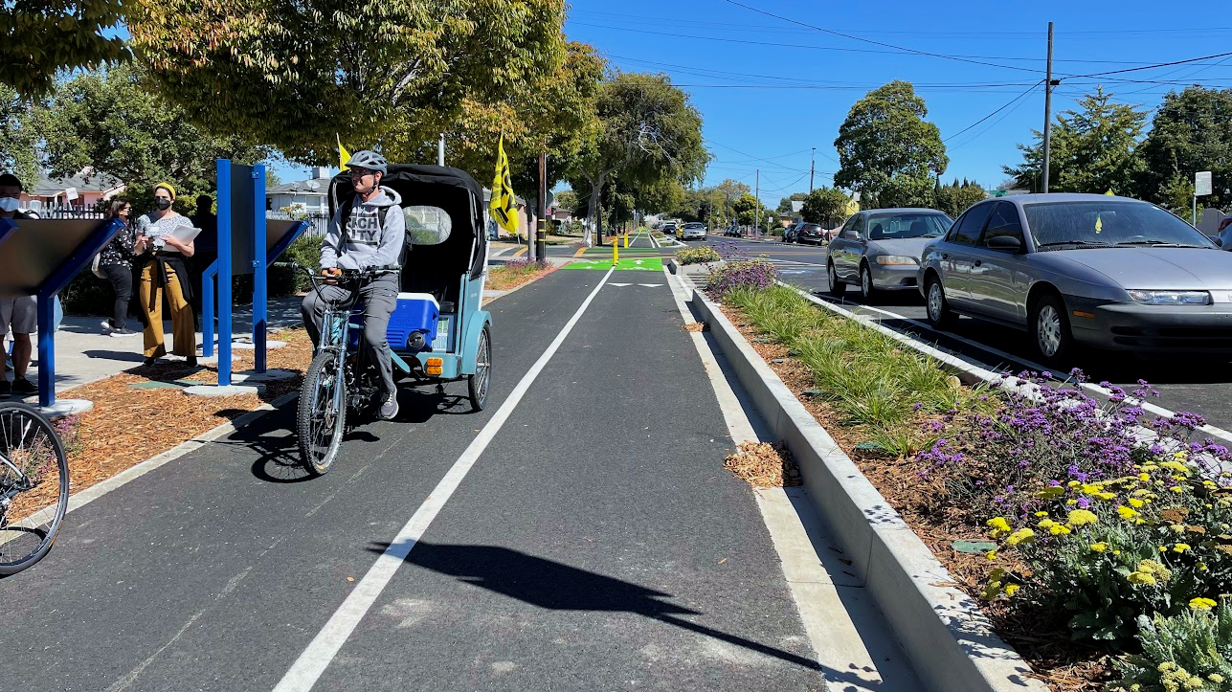


Richmond Wellness Trail
Community Health Walk: Engagement Report
Notes:
Good evening, my name is Terence Wu and I am project manager at Trust for Public Land working on the Richmond Wellness Trail. Tonight, I’ll be presenting a summary of a community engagement event we held in late October. For those of you unfamiliar with this project, the Richmond Wellness trail is a multimodal, multi-benefit greenway corridor project located here in the city of Richmond. This project is part of a larger effort to improve park access, climate resiliency, safety, and livability in Richmond. In the image shown here is the completed first phase of the project, which is a 1-mile segment that features a two-way protected bike lane, planted medians and bio-retention basins, and tree planting that runs from the Richmond BART/Amtrak Station down to Cutting Blvd. We’re now working on Phase 2, which is another 1-mile segment that connects to Phase 1 at Cutting Blvd and runs down to the San Francisco Bay.
A major advantage we now have is the completed first phase of the RWT. So, while brainstorming with the landscape architect, PlaceWorks, on how best to engage the community, we decided on a site walk, which we’ve called a Community Health Walk, which would allow people to experience the completed first phase and proposed second phase. Because of this amazing partnership within Richmond Rising, the City then connected us with Lifelong Medical, which runs the Climate Health Promoters program as a part of this TCC Grant. By collaborating, this educational and engaging event was incorporated into this cohort of Climate Health Promoter’s curriculum, and we were able to reach many more people to talk about the project.

Slide 30
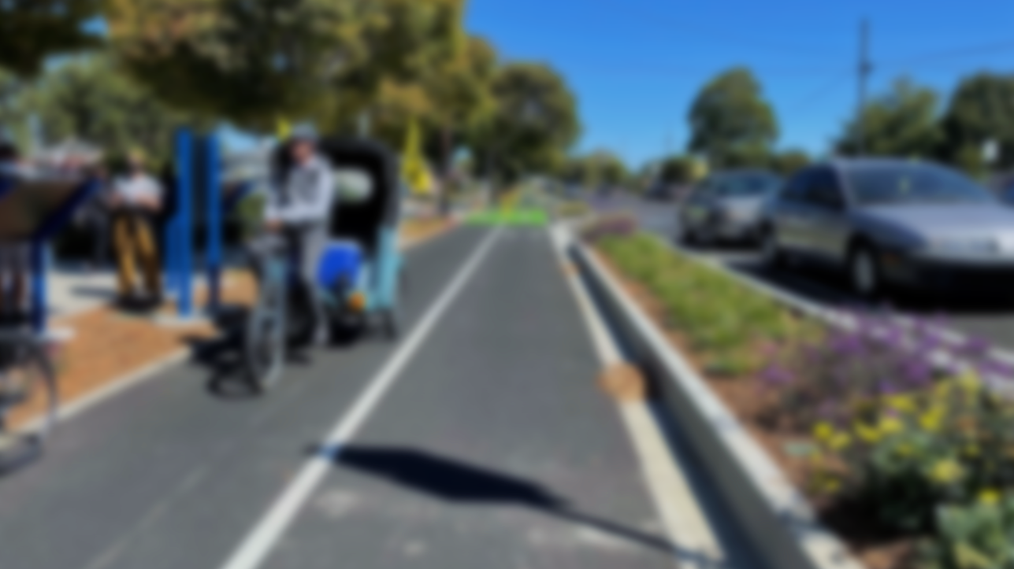

Engagement Goals
Inform the Community
Experience the Project
Hear from the Community
Notes:
As is the case with our other projects, community engagement is a key aspect of our work. Three major goals of this event were as follows:
Inform the Community. This project takes place in a public space and does affect many, so it’s important to inform people of the project. By incorporating input from the community and stakeholders, we’re able to ensure this project fits the needs and desires of the community. Not only was this event a great way to get the word out about the proposed Phase 2, it was an opportunity to talk about the completed Phase 1 and its benefits. For example, in Phase 1, there were no reductions in the number of vehicular lanes, but there was a reduction in lane width, which created the space for the planted medians and protected bike lanes. We noticed during this event that a key takeaway for many of the attendees was that the reduction of lane width is an intentional strategy employed to reduce vehicular speeds. In Richmond, speeding is a common issue referenced by the community, and by narrowing vehicular lanes, we make it less comfortable for drivers to drive as fast.
Experience the Project. As I mentioned previously, a major advantage we now have is the completed Phase 1. While Phase 2 is in a different project area and will look different than Phase 1, the completed first phase is a great example of our work. So, as a part of this event, we led people from the community to experience the completed Phase 1 and the proposed Phase 2.
Hear from the Community. After learning about the Richmond Wellness Trail and experiencing the project sites, it’s important for the community to be able to share their thoughts, concerns, and desires. To facilitate and record the feedback, PlaceWorks prepared a bi-lingual journal for people attending.

Slide 31
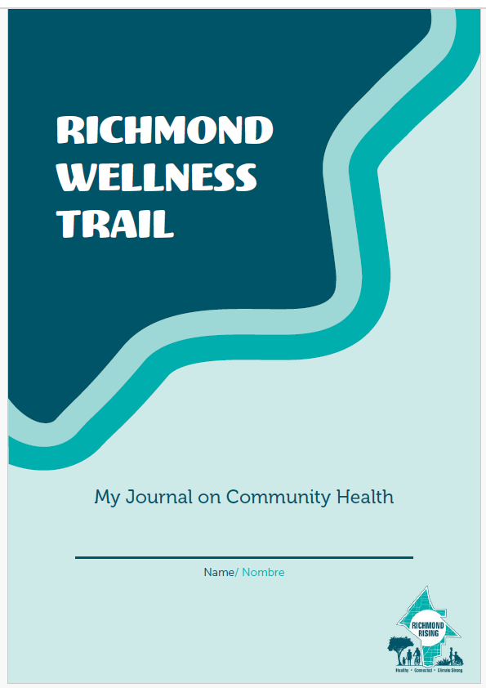
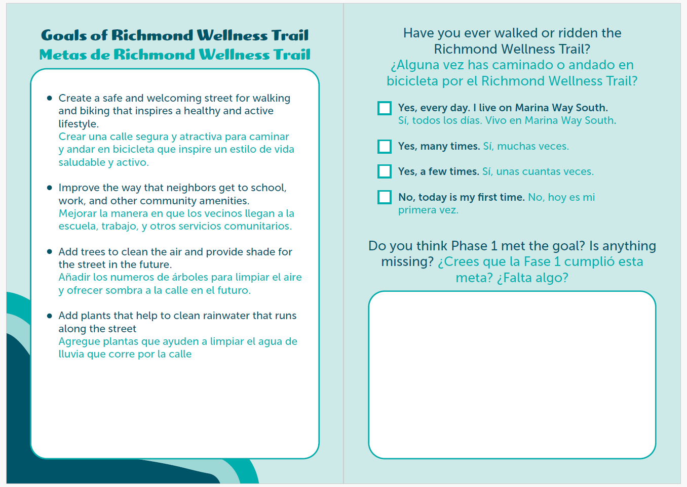
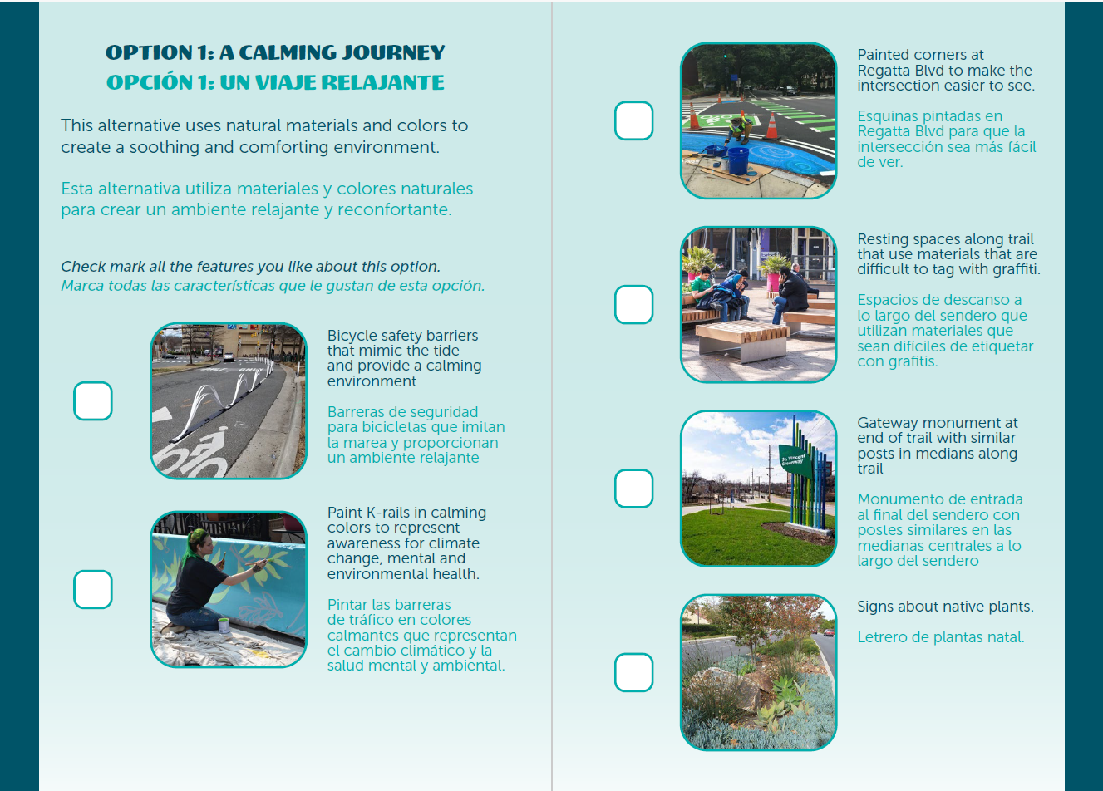
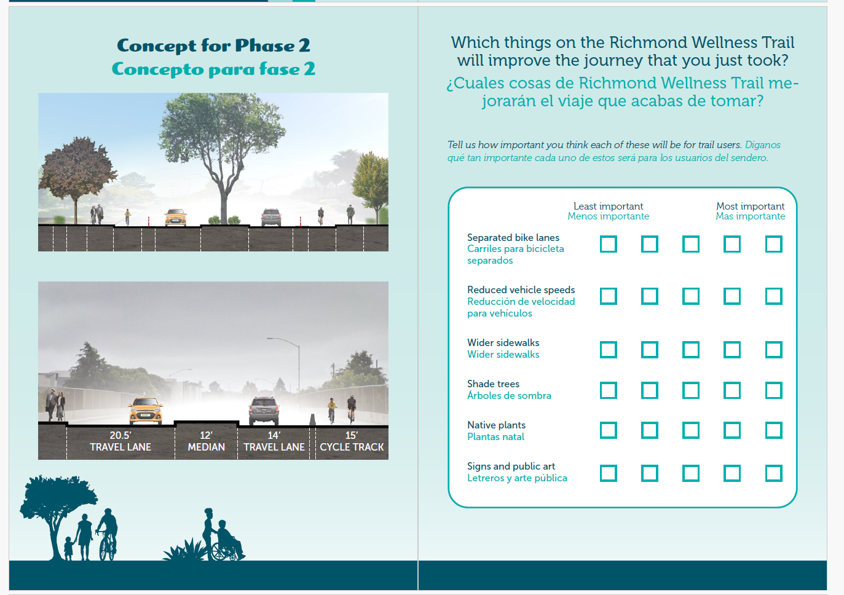
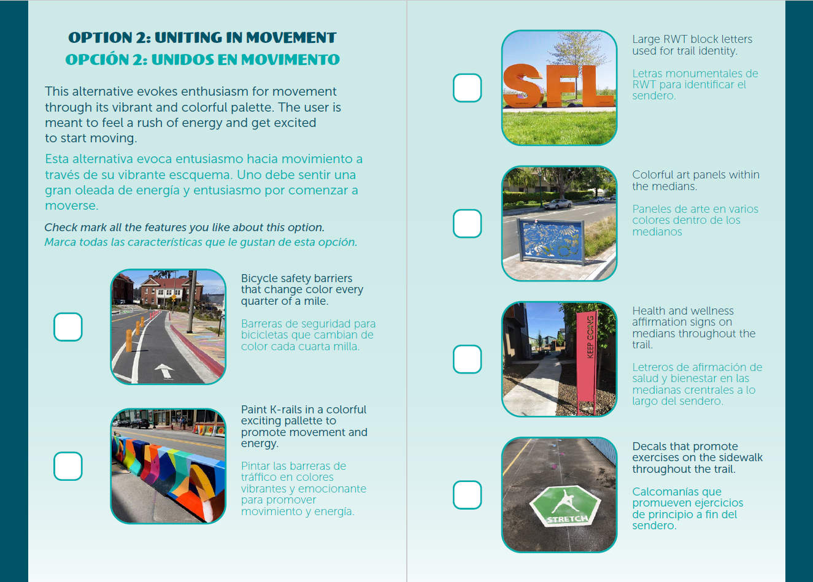
Notes:
Here are a few images of the bilingual English & Spanish journal, which provided prompts and asked overarching questions about the project. In it, we described the goals of Phase 1 and ask whether the project had met its goals, as well as if the project was missing anything. We also showed diagrams of Phase 2 and asked attendees to rate the significance of different project elements.

Slide 32

Notes:
Here’s another view of more pages in the journal. On the bottom of the slide were our questions about project identity to get folks’ thoughts on colors, signage, and aesthetics as they relate to the project.

Slide 33
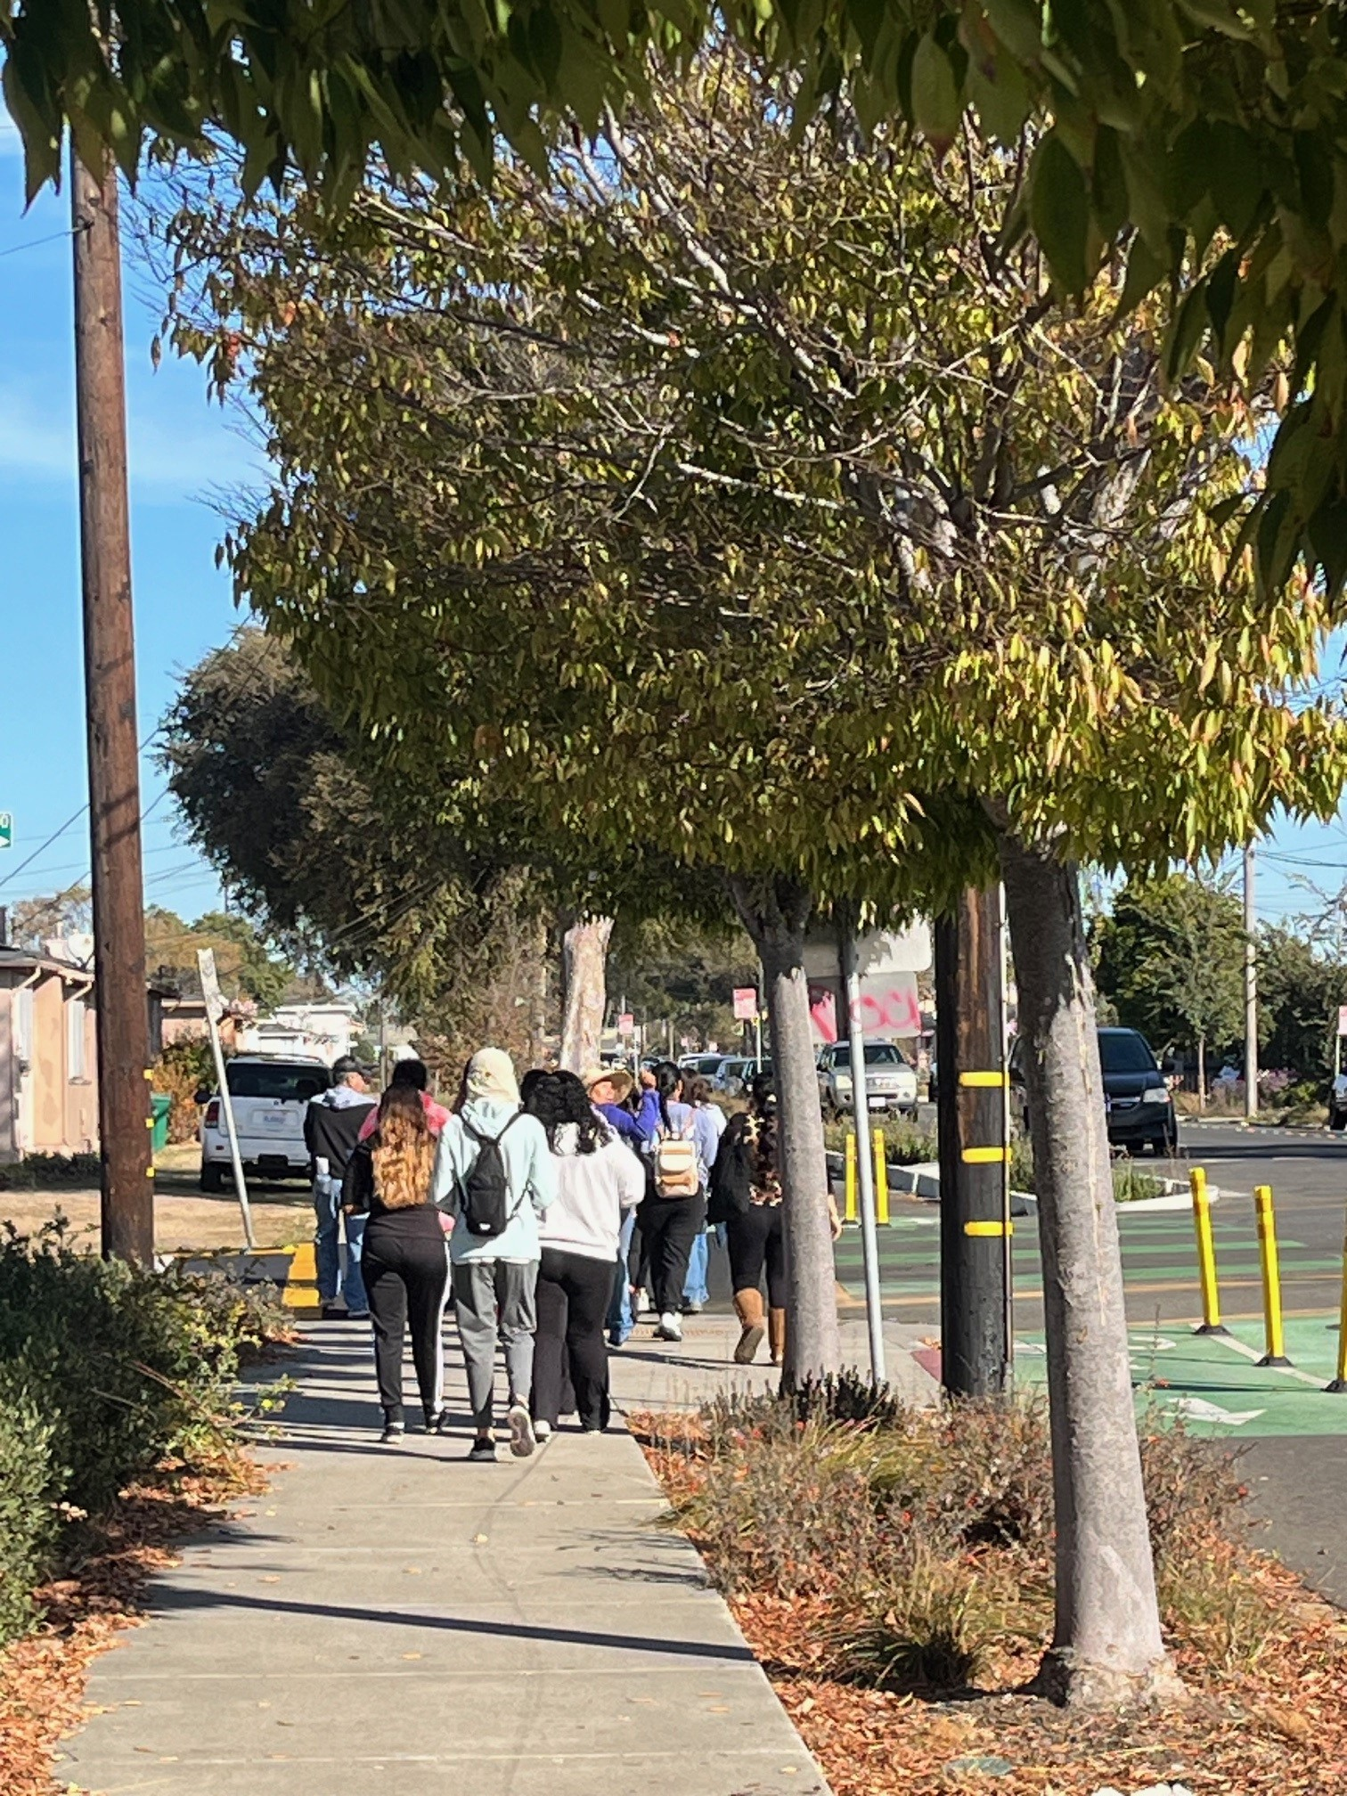
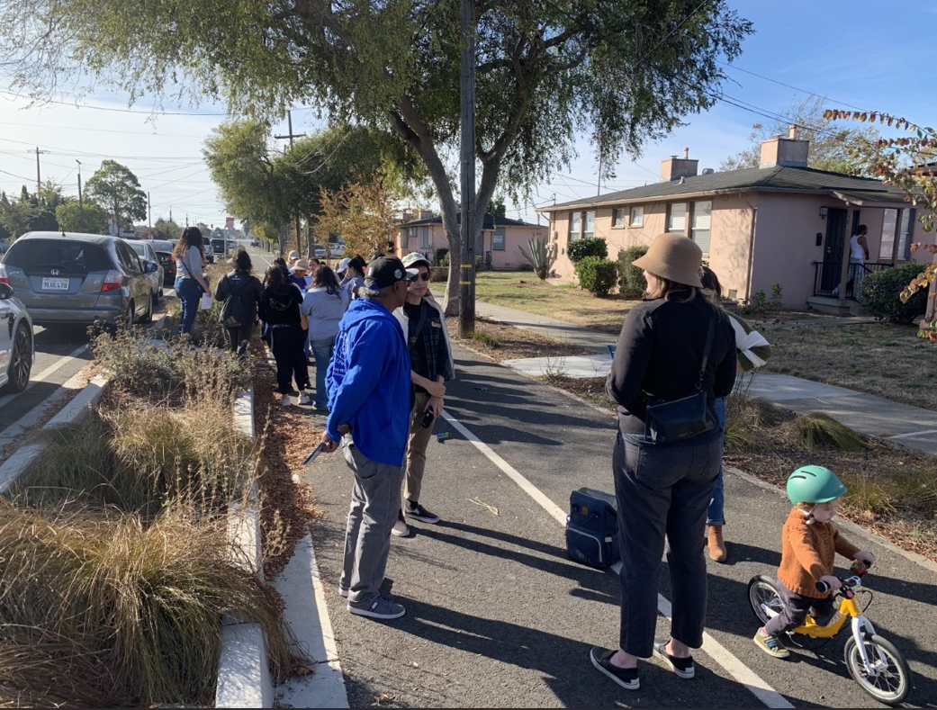
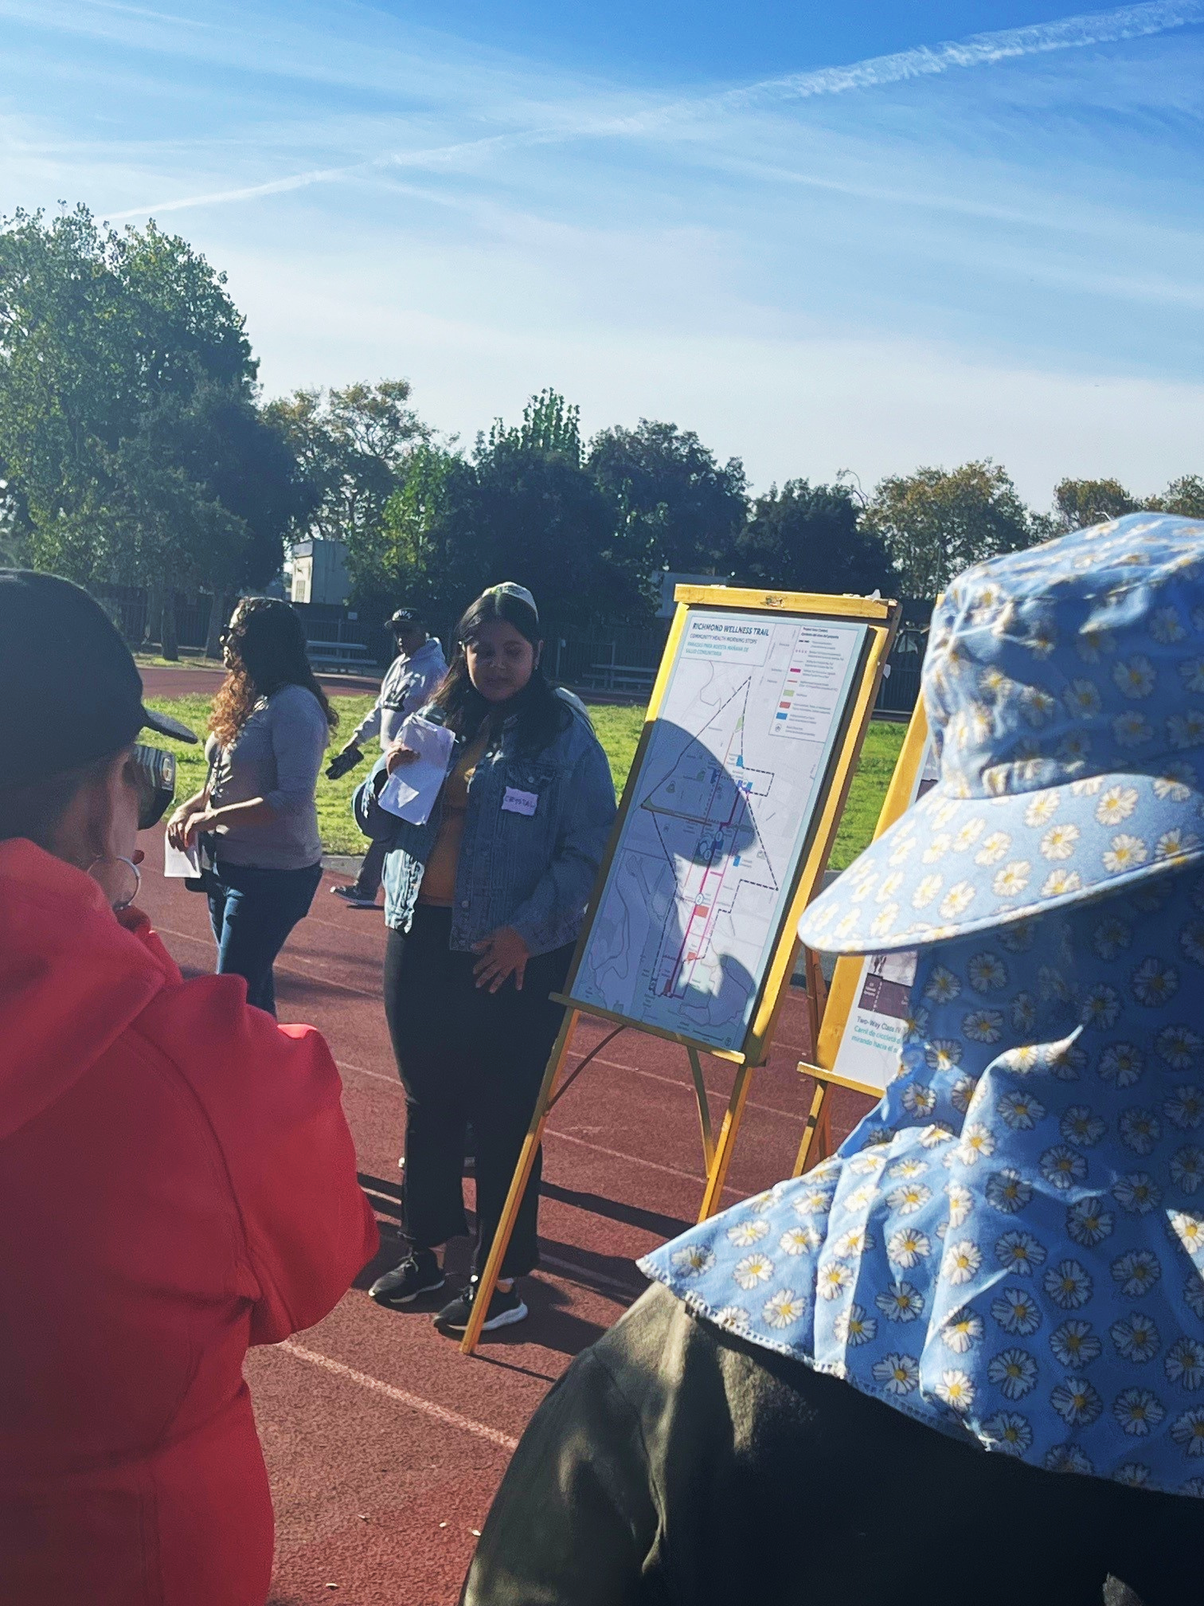
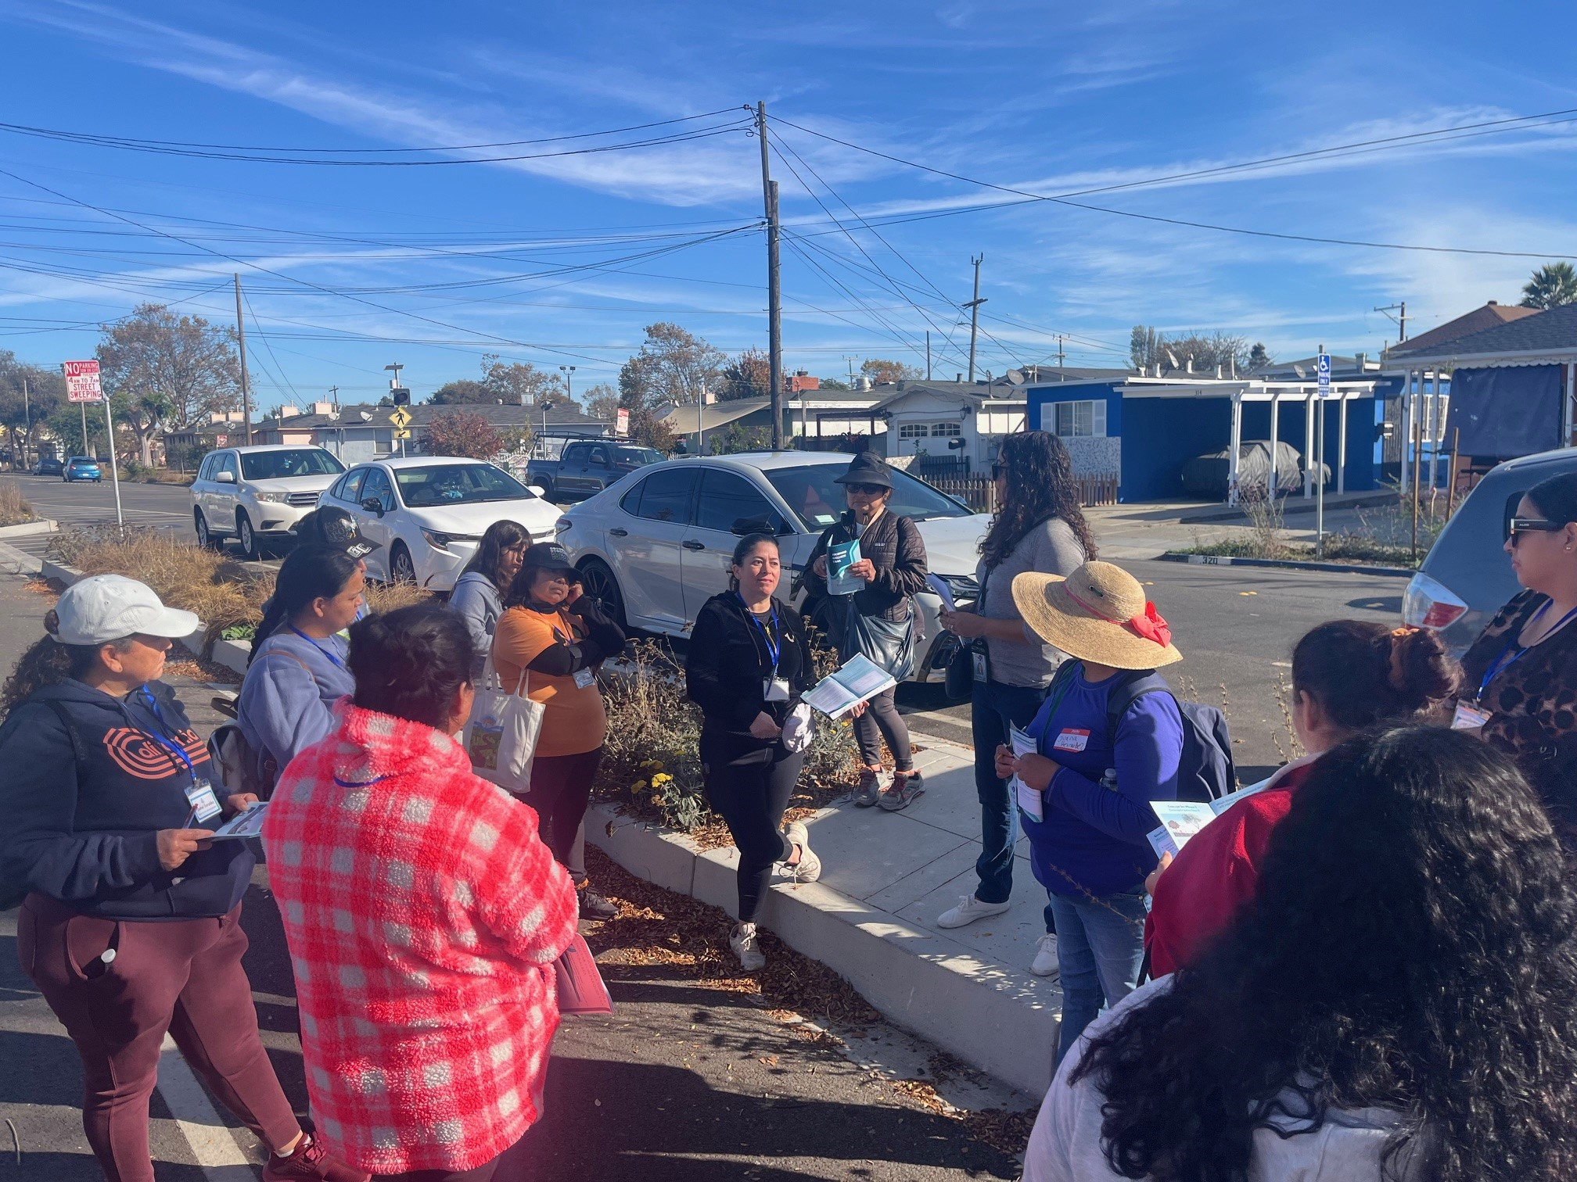
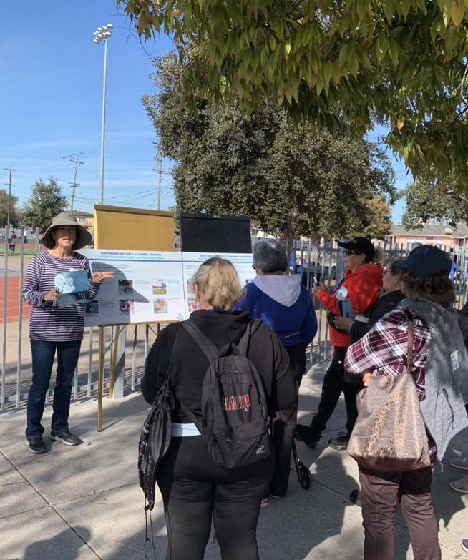
Notes:
We hosted this Community Health Walk and provided free coffee, snacks, Richmond Rising merch, and a pumpkin giveaway! At this event, we had 30 people attend, and here’s what we heard:
After walking a segment of Phase 1, folks thought
Phase 1 did meet its goals of:
Creating a space for walking and biking that improves how people can get to community amenities.
Add trees for cleaner air/water, and to create shade, as well as plants to clean rainwater.
The street was described as busy, with a high volume of traffic. Despite the project, many participants still felt that it was still unsafe due to speeding cars
Attendees noted that Phase 1 was missing the following: lighting, trash receptacles, pedestrian crossings, and overall maintenance
From there, we walked a part of the proposed Phase 2 area.
Here, participants voiced wanting longer crosswalk times and pointed out the desire for wider sidewalks, reduced vehicular speeds, and shade trees.
For wayfinding and project identity:
Participants supported themes of fitness and exercise, using markers or monuments hat had energizing colors and encouraging words.

Slide 34
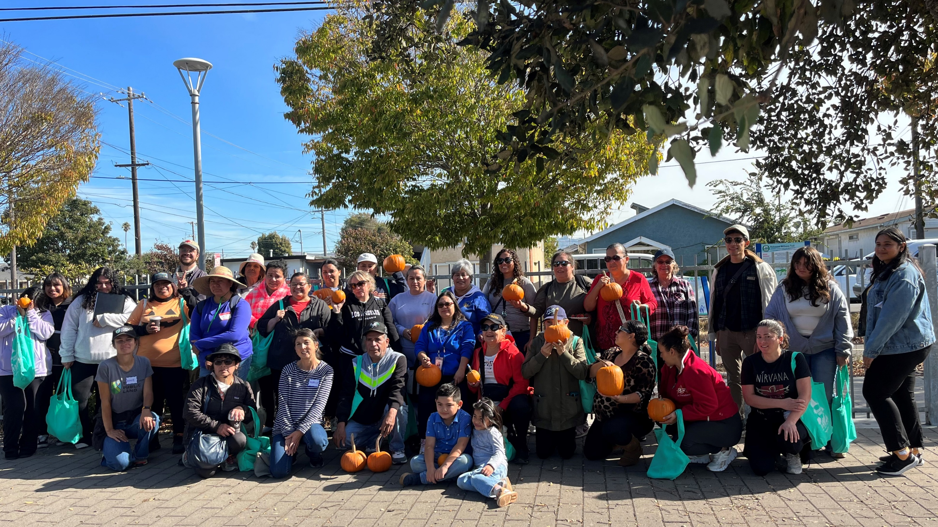

Slide 35
Thank You!

Slide 36
3. 2025 Climate Health Promoters Program Planning

Slide 37
4. Place-Based Workforce Development Strategy: Findings and Recommendations Presentation
Workforce Report still being finalized – propose tabling for future meeting

Slide 38
5. Discussion and Consideration of Project Area Office Space Rentals

Slide 39
Agenda Requests for Next Meeting

Slide 40
General Announcements
CSC Members, members of the public, and other partners or organizations are encouraged to share information or announcements related to upcoming events, projects, or programs in the Project Area
MLK Jr Day of Service – January 20th

Slide 41
Meeting Adjourned
Thank You!
Questions? Comments?
Please reach out at tcc@ci.richmond.ca.us

