Slide 1

Richmond Rising
Collaborative Stakeholder Committee (CSC)
March 5, 2025

Slide 2
Roll Call
Project lead for City of Richmond
Project lead for GRID Alternatives
Project lead for Groundwork Richmond
Project lead for Rich City Rides
Project lead for Trust for Public Land
Project lead for UC Berkeley
Project lead for Urban Tilth
Community member: Tomasa Espinoza
Community member: Juana Hernandez
Community member: Montserrat Gonzalez
Community member: Judith Rocha
Community member: Curtis Rice
Community member: Jim Becker

Slide 3
Meeting Information
Every first Wednesday of the month 6:00 – 8:00 pm.
In-person Attendance: Nevin Community Center 598 Nevin Ave, Richmond, CA 94801
Virtual Attendance: https://ci-richmond-ca-us.zoom.us/webinar/register/wn_gx8xwknptcutbnefzdbv1w
Phone Attendance: (669) 900-6833, or (669) 444-9171 Webinar ID: 976 6319 9451
All Committee members and members of the public must abide by the Community Agreements

Slide 4
Land Acknowledgement
While Richmond Rising seeks to strengthen the economy, improve public health and the environment – particularly in the Iron Triangle, Santa Fe and Coronado Neighborhoods, we do so with the awareness that we occupy unceded Huichin and Karkin Ohlone territory.
We acknowledge that land theft of indigenous homelands, and the dismantling of indigenous sovereignty, was done to advance colonization.
We acknowledge that capitalism and white supremacy are branches of colonization that have persisted throughout hundreds of years of oppression, are alive today, and contribute to keeping Black, Indigenous, and all other People of Color from thriving.
We further acknowledge that this country’s political economy and social institutions were built on the forced labor of African people on stolen land through violent, systematic abduction from their homelands and enslavement over hundreds of years.

Slide 5
Land Acknowledgement
We further acknowledge the exploitation of immigrant and refugee communities as modern forms of cheap and disposable labor are regularly carried out on stolen land.
Thus, we acknowledge that we have been impacted and harmed by these histories and experiences imposed on our ancestors and communities. We further uplift the shared struggle among Black, Indigenous, and All People of Color.
We also acknowledge that indigenous people continue to live here, steward the land, and resist settler colonialism.
We conclude that our Land acknowledgement is an active and evolving statement and process. It requires us to recognize historical injustices and invites us in to be active participants in our collective healing.

Slide 6
Richmond Rising
The City of Richmond and 6 local organizations (together known as ‘Richmond Rising’) received $35 million to bring health, economic, and environmental benefits to the Iron Triangle, Santa Fe, and Coronado neighborhoods.
Richmond Rising is supported by the California Strategic Growth Council’s Transformative Climate Communities Program.

Slide 7
Collaborative Stakeholder Committee
Provides guidance on project implementation and holds us accountable in reaching our goals
Can make recommendations, provide input, and assist Project Leads in implementing project activities
Does not have final decision-making authority
Project Leads must consider recommendations from the Committee and members of the public

Slide 8
Public Comment Not on the Agenda
This is the space for members of the public to provide public comment on items that are not included in the agenda.

Slide 9
Review and Approve Previous Meeting Minutes
Members to review and approve previous meeting minutes

Slide 10
Project Status Reports
Each partner will share up-to-date financials and grant expenditures to date for each project and this will be shared with the Committee and the public.

Slide 11

Grantee
Work completed since last meeting:
CSC Meeting: Scheduled, coordinated, and currently facilitating CSC meeting #12, including translation, refreshments, and childcare.
Invoices and Reports:
Invoice 9 was submitted
Invoice 8 changes were submitted.
Working on Amendments and Modifications.
Met with all project partners and SGC and DOC grant managers.
Met with Mayor's Chief of Staff to talk about TCC projects.
Total expenditures reported to date: $294,423.00
Remaining budget: $399,252.66
Planned work in the next ~two weeks:
Create and send new calendar for Invoice #10.
Attend RCP Grant Webinar on March 20th.

Slide 12
Neighborhood Complete Streets
Work completed since last meeting:
Engagement with Pogo Park on Neighborhood Complete Streets design
Continued coordination with partners
Hosted Town Hall #2 at Richmond College Prep.
Total expenditures reported to date: $ 31,515.98
Remaining budget: $ 5,149,657.17
Planned work in the next ~two weeks:
Meeting to discuss Federal funding issues and next steps with Richmond Wellness Trail team.
Grant & Funding Coordination: meeting to discuss scope and plans with the awarded RCP Grant

Slide 13

Richmond Wellness Trail
Work completed since last meeting:
Continued design development of construction documents
Community Engagement Planning: logistics coordination & coordination with the Climate Health Promoters
AC Transit Coordination: coordination of scope where improvements overlap and intersect
Grant & Funding Coordination: meeting to discuss scope and plans with the awarded RCP Grant
Total expenditures reported to date: $ 217,285.44
Remaining budget: $ 4,598,686.12
Planned work in the next ~two weeks:
Continued design, community engagement, and project coordination
Begin next round of community engagement

Slide 14

eBike Lending Library
Work completed since last meeting:
Participated in the Books and Breakfast Event on Feb 22, 2025
Participated at John F. Kennedy's Black History Joy Event on Friday Deb 27, 2025
Registered to 23rd St. Merchant 5 de Mayo event.
Created Branding for e-Bike Lending Library
We uploaded revised drawings and response for second plan review of the e-Bike Lending Library
Participated and assisted in Know your rights workshops
Total expenditures reported to date: $ 170,762.16
Remaining budget: $ 2,290,289.83
Planned work in the next ~two weeks:
On-the-Ground Engagement: Gathering Community Input & Selecting Branding for the e-Bike Lending Library

Slide 15

Resilient Homes
Work completed since last meeting:
Held First Planning Meeting for Summer Community TCC
Conducted Outreach at Urban Tilth Senior Garden Day
Conducted Outreach at Iron Triangle BHM Event
Increased TCC Client pipeline by 10
Total expenditures reported to date: $ 774,871.46
Remaining budget: $ 6,191,824.45
Planned work in the next ~two weeks:
Deploying Outreach Team to 4 Partner Events
Creating TCC Video for advertising

Slide 16

Basins of Relations
Work completed since last meeting:
Installed 2 drip irrigation systems and 1 laundry-to-landscape greywater recycling system for Iron Triangle homeowners.
Completed native plant nursery workdays to grow drought-tolerant plants for future installations.
Total expenditures reported to date: $ 256,767.27
Remaining budget: $ 1,423,936.51
Planned work in the next ~two weeks:
Hopefully beginning installation of our first water catchment system pilot project, helping to educate our staff and refine our methods for this new type of installation.
Additional drip irrigation and laundry-to-landscape system installations for Iron Triangle homeowners!

Slide 17

Bosque del Barrio
Work completed since last meeting:
17 Trees planted, 10 non-residential, 7 residential
Continue to canvass in designated neighborhoods for tree adoptions- 30 new adoptees* in Feb
Ongoing maintenance for planted trees & trees that were vandalized at Lucas Park
Total expenditures reported to date: $ 163,499.74
Remaining budget: $924,513.01
Planned work in the next ~two weeks:
Graduation of Workforce Cohort 3 on March 26
Coordinating Clean-up for Cesar Chavez day March 31

Slide 18
ADA Accessible Garden
Work completed since last meeting:
Submitted responses to the City of Richmond on the permitting process
Total expenditures reported to date: $ 91,853.13
Remaining budget: $ 863,190.87
Planned work in the next ~two weeks:
Finalize permitting process
Put the project out to bid

Slide 19
Orchard for ALL!
Work completed since last meeting:
Interviewed potential Gleaner Apprentice applicants
Procurement of Fruit Trees for Annual Fruit Tree giveaway from Planting Justice
Onboarded 4 apprentices for the 6-week training program
Total expenditures reported to date: $ 151,823.99
Remaining budget: $ 1,016,389.64
Planned work in the next ~two weeks:
Conduct 6-week training program for apprentices with Graduation date on April 4th
Host Annual Fruit Tree Giveaway on March 8th at Unity Park for project area
Residents
Begin annual report on training program and fruit tree giveaway
Follow up with Fruit Tree Giveaway Recipients on-site consulatations

Slide 20
Veggie Rx
Work completed since last meeting:
Hosted a Climate-Friendly Diet Workshop (Mushroom Taco Demo) at LifeLong Medical on Feb. 19th
Continued recruitment for May 2025 Climate Health Promoters Training (15 spots remaining)
Began work to streamline CalAIM data tracking with a consultant to increase Veggie Rx enrollment
Total expenditures reported to date: $ 692,962.44
Remaining budget: $ 2,545,909.56
Planned work in the next ~two weeks:
Plan CFD workshop with FIERCE Advocates on March 20th – 5:30 – 7 pm
Update CFD Recipe book with new submissions from community members
Schedule CFD workshops for May/June

Slide 21
E-Bike Share
Work completed since last meeting:
Continued maintenance and operations of existing bike hubs
Survey for additional location in District 5 (outside of Project Area)
Ride Today and City in the process to set a meeting to discuss most recent data
Total expenditures reported to date: $ 499,608.31
Remaining budget: $ 499,370.90
Planned work in the next ~two weeks:
Continue collecting responses from survey.

Slide 22
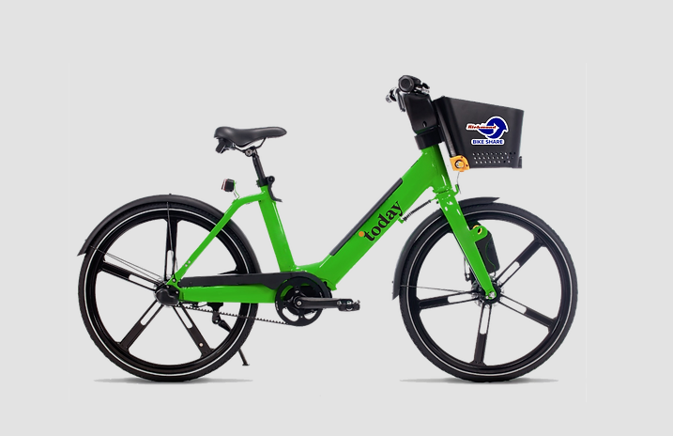

District 5 Hub Survey
Powering a New Era of Travel

Slide 23
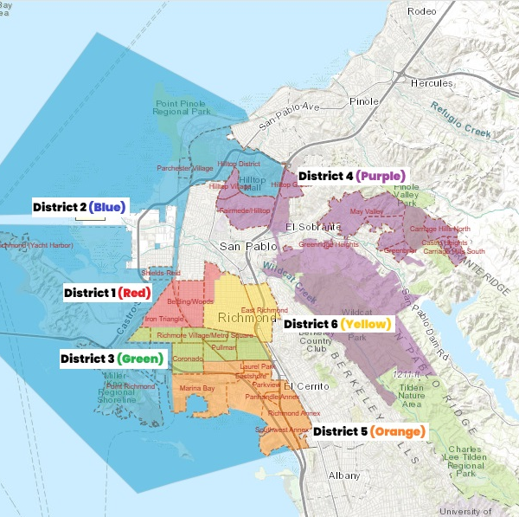
Where is District 5?
Highlighted Orange
Begins in Marina Bay stretches down to The Richmond Annex
Notes:
Describe landmarks

Slide 24
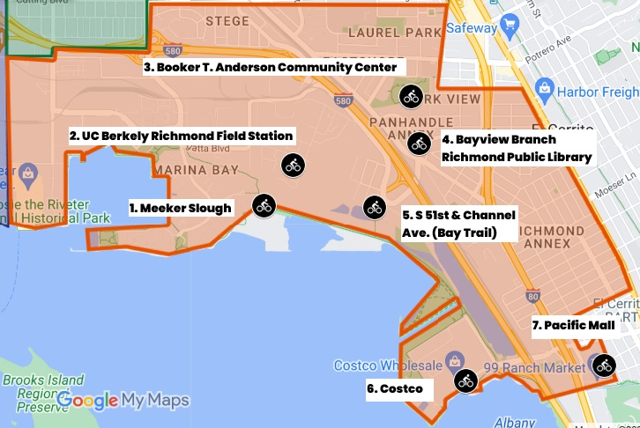
What Locations?
Meeker Slough
UC Berkely Richmond Field Station
Booker T. Anderson Community Center
Bayview Branch Richmond Public Library
S 51st & Channel Ave.
Costco
Pacific Mall

Slide 25
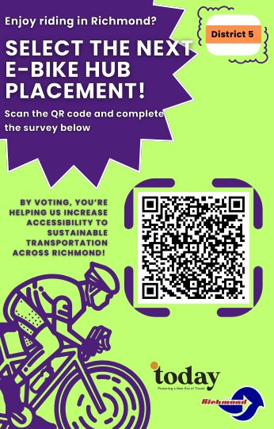
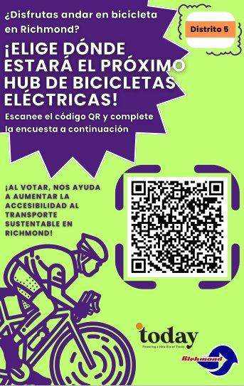

Slide 26
Community Engagement Plan
Work completed since last meeting:
Youth Fellow Program:
Currently in the hiring process- We've had 18 applicants so far. Out of those 18 applicants, 16 have been interviewed. Out of those 16 applicants only 12 have been offered the youth fellow position. The remaining applicants that were not offered the position didn't qualify because they do not meet the eligibility requirement for either living within the 3 project neighborhoods or a Richmond resident.
Tabling/ Outreach: Tabled at John F. Kennedy High Schools Black History Joy Event.
Youth Fellow Project Manager & TCC Coordinators were figuring out logistics around the payment process for the Youth Fellow Stipends. This caused for a bit of a delay to the start of the program that was set to start March 1st but now pushed to the end of March.
Total expenditures reported to date: $ 232,708.89
Remaining budget: $ 2,333,323.84
Planned work in the next ~two weeks:
Youth Fellow Program:
Offer letters are currently being prepared and will be sent out by the end of week.
Print & prepare material for training sessions.
Tabling/ Outreach: Tabling at Because of Youth Festival 3/30

Slide 27
Displacement Avoidance Plan
Work completed since last meeting:
Prepared contracts for City Council approval for Bludot Open Rewards and the Buy Local Events and Marketing Consultant.
Both Vendors met with Risk Management and City team and working to comply with City’s insurance requirement.
Worked on vendor forms, MUNIS contract entry, and other administrative tasks for contract execution.
Onboarded Housing Fellow to work on the Community Land Trust policy.
Total expenditures reported to date: $ 148,018.22
Remaining budget: $ 533,617.40
Planned work in the next ~two weeks:
Finalize contract execution for Bludot Open Rewards and the Buy Local Events
and Marketing Consultant.
Notes:
The levying of taxes for DRPBID is applicable to many parcels in the downtown area. The money goes to improving the Downtown area and is also the budget for Richmond Main Street Initiative.

Slide 28
Workforce Development and Economic Opportunity Plan (WDEOP)
Work completed since last meeting:
GRID Alternatives:
Created posts on social media, in our regional newsletter, and a new page on our website for recruitment for solar training
Continued preparation of solar training program including building out of the training space and purchasing classroom tools and supplies
Canvassing/flyer drop for recruitment flyers at community organizations and city buildings
Total expenditures reported to date: $ 176,922.24
Remaining budget: $ 1,256,885.50
Planned work in the next ~two weeks:
GRID Alternatives continuing to recruit for paid solar training program

Slide 29

Indicator Tracking Plan
Work completed since last meeting:
Received Feedback from the City on Year 1 Evaluation Report
Began implementing feedback
Drafted an invoicing package with revised documentation
Total expenditures reported to date: $ 0
Remaining budget: $ 1,070,000
Planned work in the next ~two weeks:
Complete revisions of Year 1 Evaluation Report
Create a work plan for the Year 2 Evaluation report, including data collection & CARB reporting methodologies

Slide 30
Report on Public Comments & Questions
Report out on any community questions or comments received, including responses

Slide 31
Committee Business Items for Discussion
Youth Fellows Status Update and Project Engagement Planning
Electric Bike Lending Library Logo Review and CSC Recommendation
Neighborhood Complete Streets update
Richmond Wellness Trail survey presentation
Know Your Rights Training

Slide 32
Youth Fellows Update and Planning
Hiring Process Updates:
We currently have 3 youth fellow positions still open.
The Youth Fellow Project Manager will continue actively recruiting and interviewing till the 3 remaining youth fellow positions get filled.
Please continue to share the Youth Fellow Flyer with friends and family.
Eligibility Requirements:
Be between 16 and 24 years of age.
Live, work, or study in the Iron Triangle, Santa Fe, or Coronado Neighborhoods or be a Richmond Resident. But priority is given to those who live within the three project neighborhoods.
Youth Fellows Outreach Request Form:
As the start of the Youth Fellow Program approaches as a project lead or partner it is important to start thinking of the different ways our Richmond Rising Youth Fellows can get involved with your projects.
Since the Youth Fellow Program is part of our Community Engagement Plan we want to get our youth fellows involved in all things Richmond Rising.
This means that you will get the opportunity to request youth fellows throughout the year to help be part of your Richmond Rising projects.
Please keep the following in mind when making a request: Make sure the task you are requesting the youth fellows for align with a Richmond Rising project per our TCC guidelines.

Slide 33
Youth Fellows Update and Planning
What are some tasks you can request the Youth Fellows for?
Outreach/ informational tabling assistance
Assist at a station during an event
Assist during a bike ride event
Resident interviews/surveys for outreach purposes
Assistance with a social media post
Attend a community meeting
Other things to consider when making a request:
How many youth fellows will you need?
Will there be a dress code the youth fellows need to follow?
Will the youth fellows need to bring any materials?
Will snacks and/ or lunch be provided?
If assistance is needed in another city will transportation be provided?
What will be the duties and responsibilities of the youth fellows.
When are partners expected to receive access to the Youth Fellows Outreach Request Form:
I will be sharing the form during April's CSC meeting.

Slide 34



EBLL Logo

Slide 35
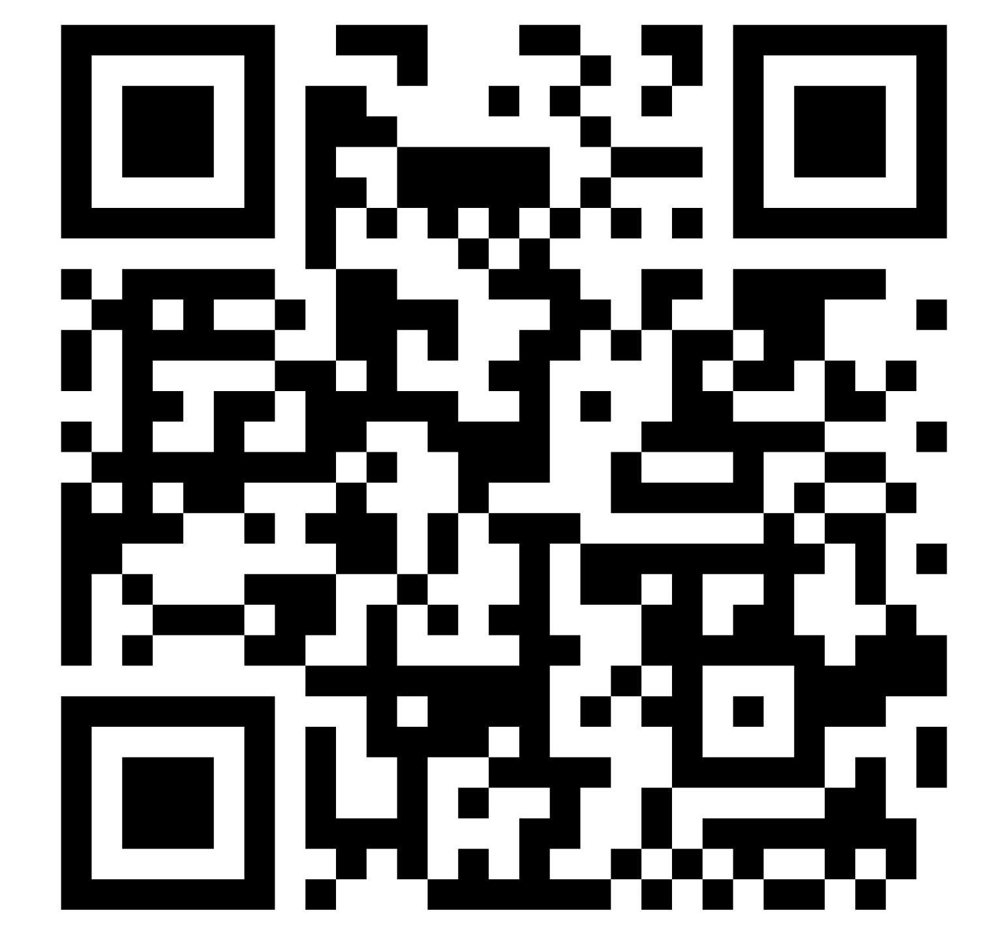
Cast Your Vote!
Help us pick the e-BBL Logo design!
Scan me or visit the URL below.
Escaneame o visita el enlace abajo.
https://forms.gle/fu8cwgYpKGtqp5137

Slide 36
Neighborhood Complete Streets Update

Slide 37
Richmond Wellness Trail survey presentation

Slide 38
Know Your Rights Training
Purpose of training:
Understand constitutional rights in interactions with ICE
Understand legal requirements for ICE officers, and how best to engage
Understand availability of immigration support
Note: This training is not a substitute for legal advice on specific cases – please consult an attorney for support with ongoing legal cases.
Notes:
We don’t know everything, and the situation is changing

Slide 39
Know Your Rights Training
Federal Administration seeking large-scale deportations, reduction/termination of Temporary Protected Status (TPS) program
Targeting sanctuary cities through withholding federal funds and increasing enforcement to compel jurisdictions to cooperate with federal immigration enforcement

Slide 40
California Protections
California Values Act (SB 54) signed in 2017 and prohibits local agencies from assisting Federal immigration enforcement (except for serious crimes)
Restricts ICE access to local jails, bars extended detention for minor infractions without a judicial warrant.

Slide 41
City of Richmond
Sanctuary City Policy: Prohibits any City Department or contractor from collecting and sharing data with ICE
Feb 2nd: RPD Statement: We will never question a persons immigration status, and we do not detain individuals for civil immigration violations. We DO NOT participate in ICE raids or assist in federal immigration enforcement.
March 4th: Council approved $1M for immigrant legal services and public awareness campaigns

Slide 42
Know Your Rights Training
Despite these laws, ICE is allowed to legally conduct activities in the City

Slide 43
Know Your Rights Training
YOU HAVE RIGHTS - NO MATTER YOUR IMMIGRATION STATUS!

Slide 44
If ICE Comes to Your Home
Two ways ICE can enter your home:
Valid Warrant
Your Permission
Do not open the door - can be construed as permission to enter
Always ask for identification – officers required to identify themselves
Ask to see a warrant
You have the right to remain silent
Notes:
You have the rights, but ICE may not be respecting your rights. Knowing and exercising your rights can help your case.

Slide 45
Do NOT Open the Door
You have the right to NOT open the door
You have the right to see a warrant
A warrant is a paper signed by a judge giving the officer permission to enter your home
The warrant will specify the areas that the official has the right to search
Make sure the shown document is a warrant

Slide 46
Do NOT Open the Door
Ask the officer to slip the warrant underneath the door. If you open the door and allow the official to come into the house, this may be considered giving him/her “consent” to enter.
If you have a window, have the ICE officer display the warrant on the window. Also, check the signature is filled out by a judge.
If s/he enters without a warrant, request the names and badge numbers of the officers and say that you did not “consent” to a search. Write down the names, addresses and phone numbers of anyone who witnessed the incident.
If the officer has a valid warrant, you are legally required to let them in. Observe whether the official searches any other areas that are not listed in the warrant.
Get a receipt for any property taken by the official.

Slide 47
At any time, you have the right to:
Remain silent
Ask for a valid search warrant
Ask for an attorney

Slide 48
If ICE Stops You in Street or Public Area
Do NOT run away
Before saying anything, ask “Am I free to go?”
You have the right to remain silent
If searched, say “I do not consent to this search”
You are allowed to record the interaction

Slide 49
If ICE Stops You in Street or Public Area
If the police or an immigration officer stops you on the street and does not have a warrant, they may not arrest you unless they have evidence that you are a non-citizen.
REMINDER: YOU HAVE THE RIGHT TO REMAIN SILENT AND TO REFUSE A SEARCH!
Do NOT say anything about your immigration status or where you were born.
Do NOT carry any documents from your country of origin or false documents.
If you have valid immigration status documents, show them.

Slide 50
If stopped in a vehicle
If local law enforcement stops you—for example, police or state highway patrol—the driver must show their driver’s license, registration, and proof of insurance upon request. Immigration status documentation is not required.
If ICE stops you - drivers and passengers have the right to remain silent. You can tell ICE you are using your Fifth Amendment right to remain silent and ask if you are free to leave. People should never provide any information about immigration status.
Can also hold Red Card in window (add’l information in subsequent slides)
How can you tell the difference between local law enforcement and ICE?
Ask!
Local law enforcement should identify themselves as such.
ICE will often be in plain clothes (not in uniform) but may be wearing some clothing that states “ICE” or “ICE police.” May not identify themselves as ICE.

Slide 51
If you are arrested
Find out who has arrested you
Write down the name of the officers and their agency (Police Dept., FBI, Immigration, County Sheriff), along with their identification numbers and license plate numbers. You can find this information on their uniform or their cars, and are allowed to record this information.
Don’t sign any documents before speaking with a lawyer.
You always have the right to speak with a lawyer, no matter your immigration status. Government officials may try to intimidate or coerce you into signing. However, you may be signing away your right to a hearing before an immigration judge, and you should not sign without confirming with a lawyer.
Contact your attorney or a famIly member
You have the right to make a telephone call after you are arrested. Memorize the telephone number of your attorney, family member, friend or union spokesperson, and contact him/her immediately.
Make a plan!
If you have children or elderly relatives, ask your family to make arrangements in advance for a family member or friend to care for them in case of detentions.
Make sure you designate individuals you trust to make decisions for you if you are detained.

Slide 52
Make a plan
Take action now!
Make sure everyone in your family knows their rights
Memorize important information
Get screened for immigration options
Work with your family to make a plan
Make copies of all immigration and other important documents
Save money
Remain vigilant

Slide 53
Make a plan
Talk to an immigration service provider about your immigration options:
If you have a green card, find out if you can become a US Citizen
If you are here on a visa, find out if you can get a green card
If you do not have immigration status, find out if you may be eligible for a visa or work permit
If you have a criminal arrest or conviction, find out how it might affect your case or if there is a way to remove it from your record
Beware of notary fraud!

Slide 54
Immigration Red Cards
Includes important reminders of your rights
Provide a clear statement that can be shown to immigration officers or law enforcement, asserting your rights and requesting legal representation before answering any questions
Can help mitigate language issues in asserting rights
At the sign-in table – please take as many as you need and share

Slide 55
Example Scenario
ICE Officer: Hey. Where are you from? Where were you born?
Parent: I have the right to remain silent.
ICE Officer: Where’s your ID?
Parent: I have the right to remain silent.
ICE Officer: You must answer my questions. I am a police officer in this city.
Parent: I have the right to remain silent.
ICE Officer: You are going to have big problems if you don't answer my questions.
Parent: I have the right to remain silent. Am I free to leave now?

Slide 56
Additional Resources
List of Rapid Response Networks and Hotlines from California Collaborative for Immigrant Justice
Immigration Legal Resource Center (ILRC) red cards - provide them to people at risk.
What Immigrants Should Know About Their Rights in Richmond – article from Richmondside newspaper
For small businesses and nonprofits, review Public Counsel's FAQ, or information specific to health clinics, K-12 schools, and homeless service providers. The FAQ includes samples of valid and invalid warrants.
We Have Rights- Spanish video series on our rights with ICE in different settings
Know Your Rights: Guide for Immigrant Communities – resources from Tenants Together
Protecting Tenants from Immigration Status Harassment – resource from Tenants Together
This tracking tool provides an updated list of changes to federal immigration policy. Always consult an attorney regarding individual cases or issues
Ongoing Know Your Rights trainings are being held throughout the City by Reimagine Richmond and other organizations.

Slide 57
Additional Resources
If you have additional questions or want to know more about your rights, contact Stand Together Contra Costa at
(925) 900-5151 or
https://standtogethercontracosta.org/

Slide 58
Agenda Requests for Next Meeting

Slide 59
General Announcements
CSC Members, members of the public, and other partners or organizations are encouraged to share information or announcements related to upcoming events, projects, or programs in the Project Area

Slide 60
Meeting Adjourned
Thank You!
Questions? Comments?
Please reach out at tcc@ci.richmond.ca.us

